Slide 1
Infectious disease challenge 1: Develop a platform for discovery and analysis of correlates of protection
Main focus: tools to identify correlates across unconnected datasets
Key points: FUNCTIONALITY AND POTENTIAL
PLATFORM NAME?????
Random Forest Rangers
Gokhan Tut, Duncan Murray, David Bone, Wayne Croft
Notes:
15 mins
7.5 mins for demo
7.5 mins for answering the set quesions

Slide 2
SIMPLE GRAPHICAL WORKFLOW

Slide 3
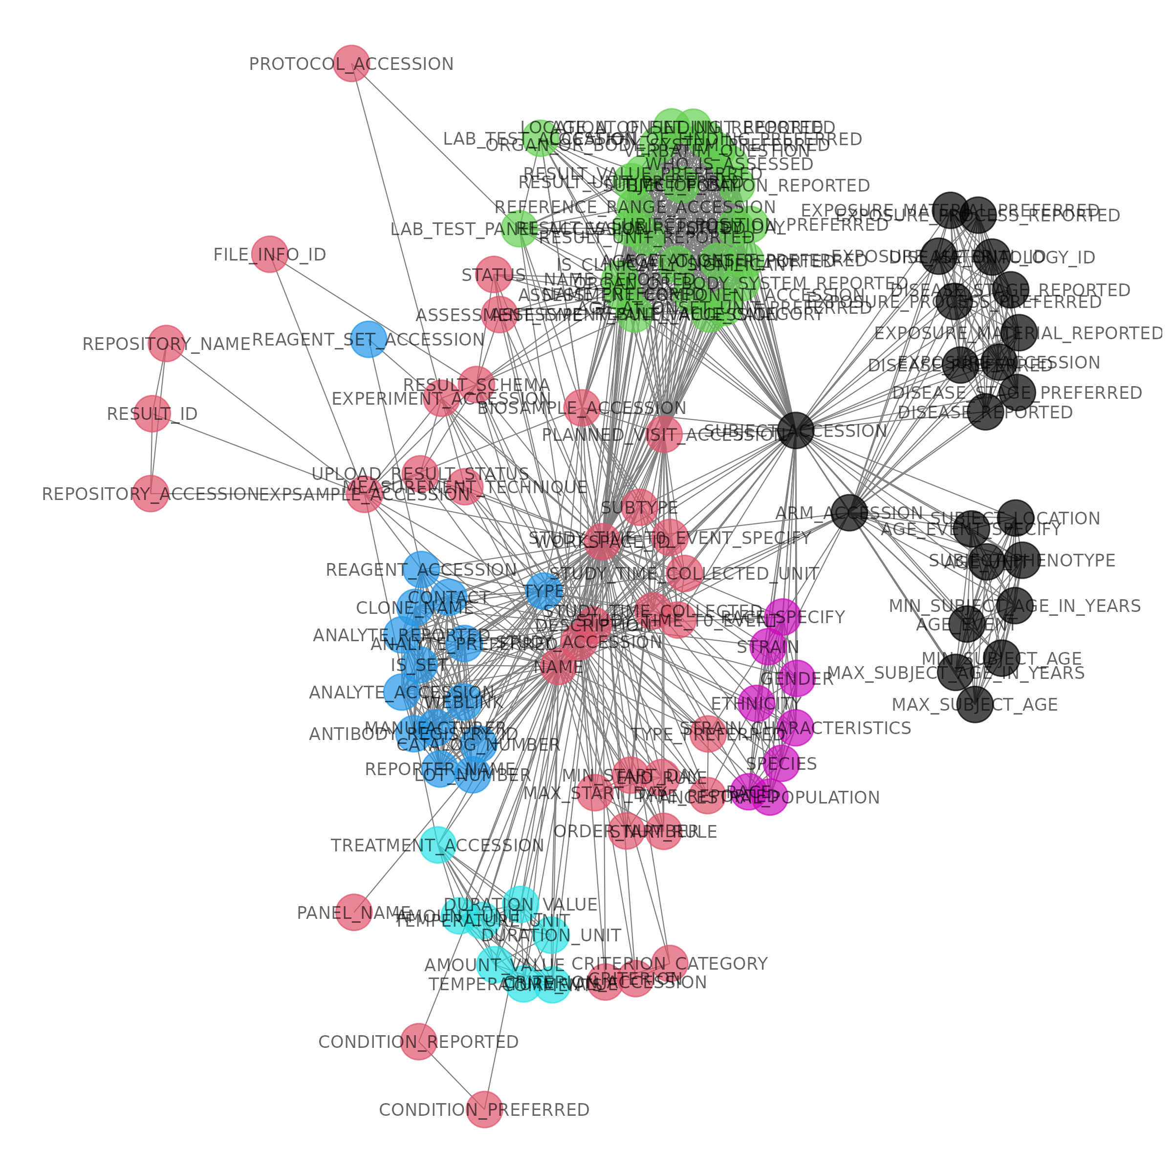
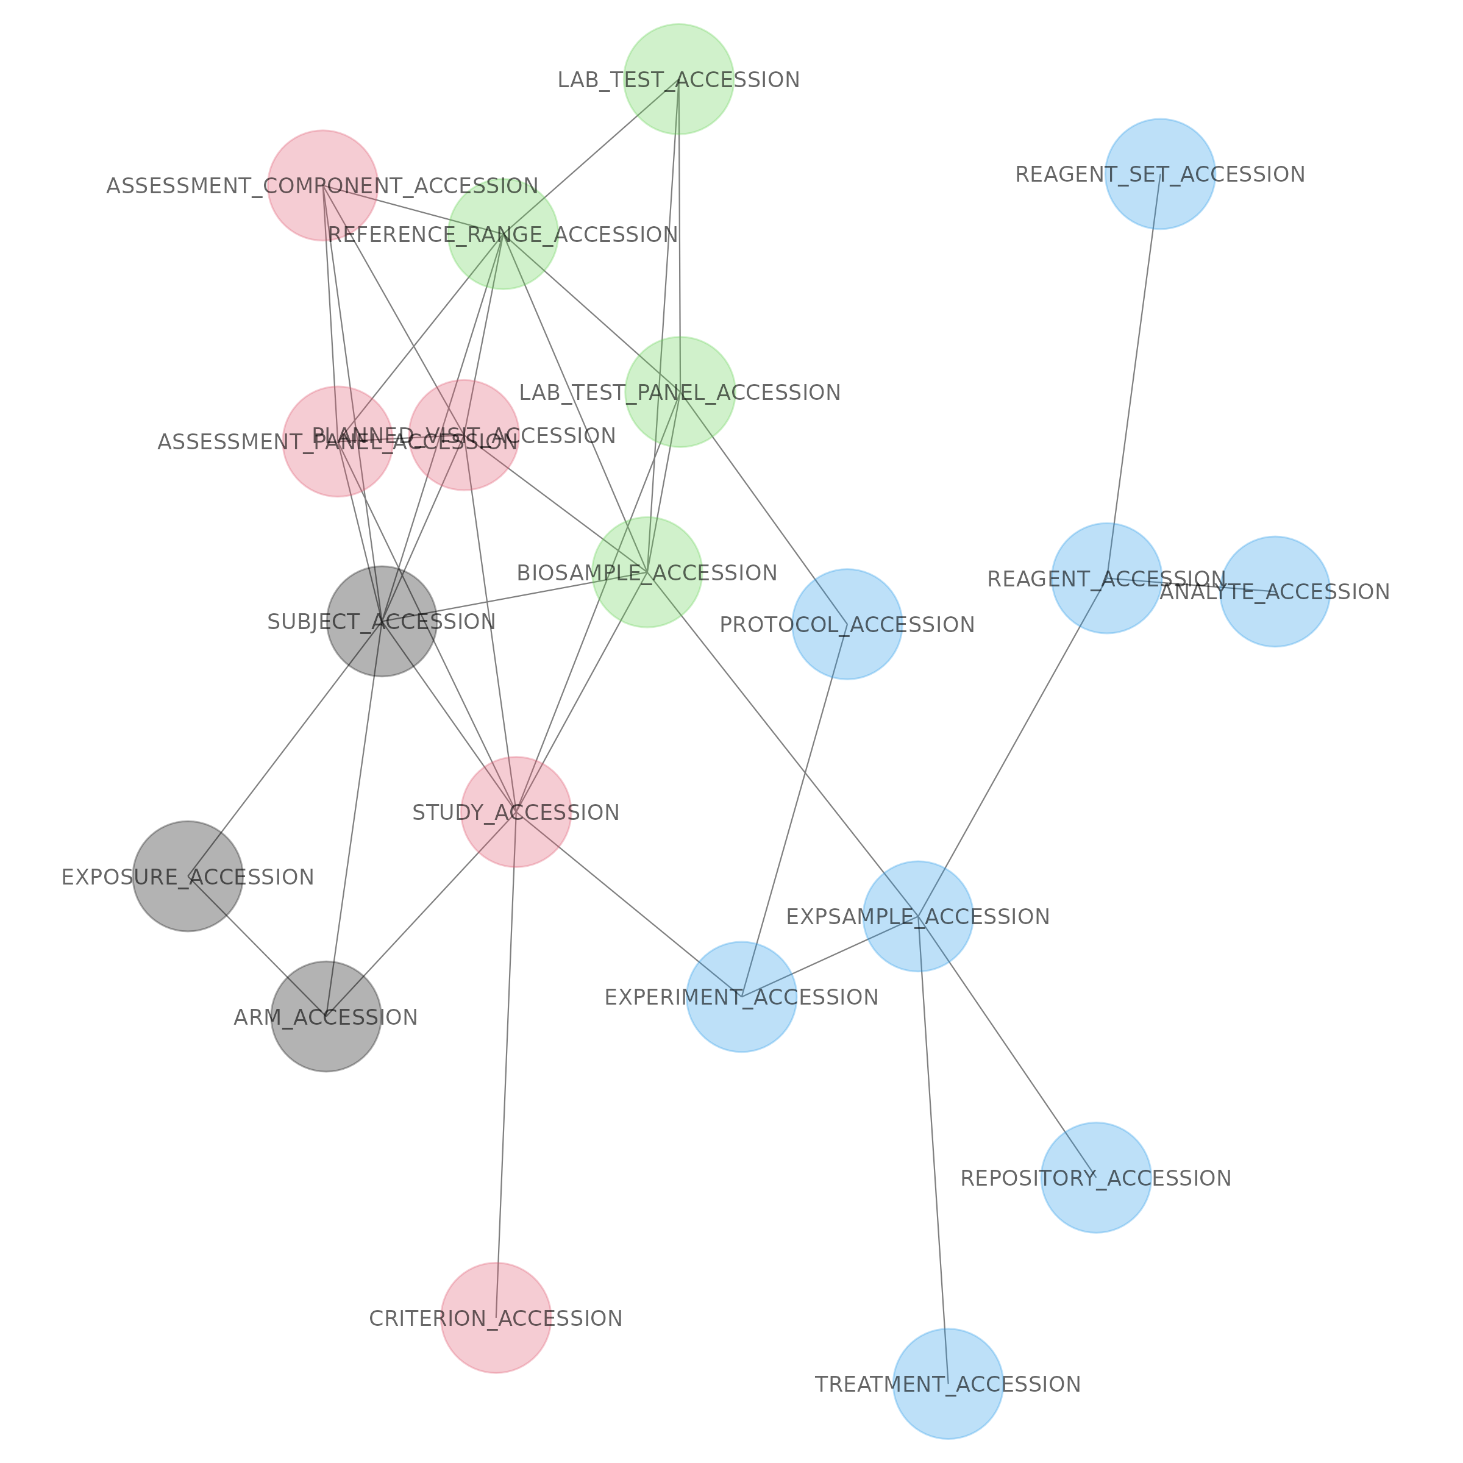
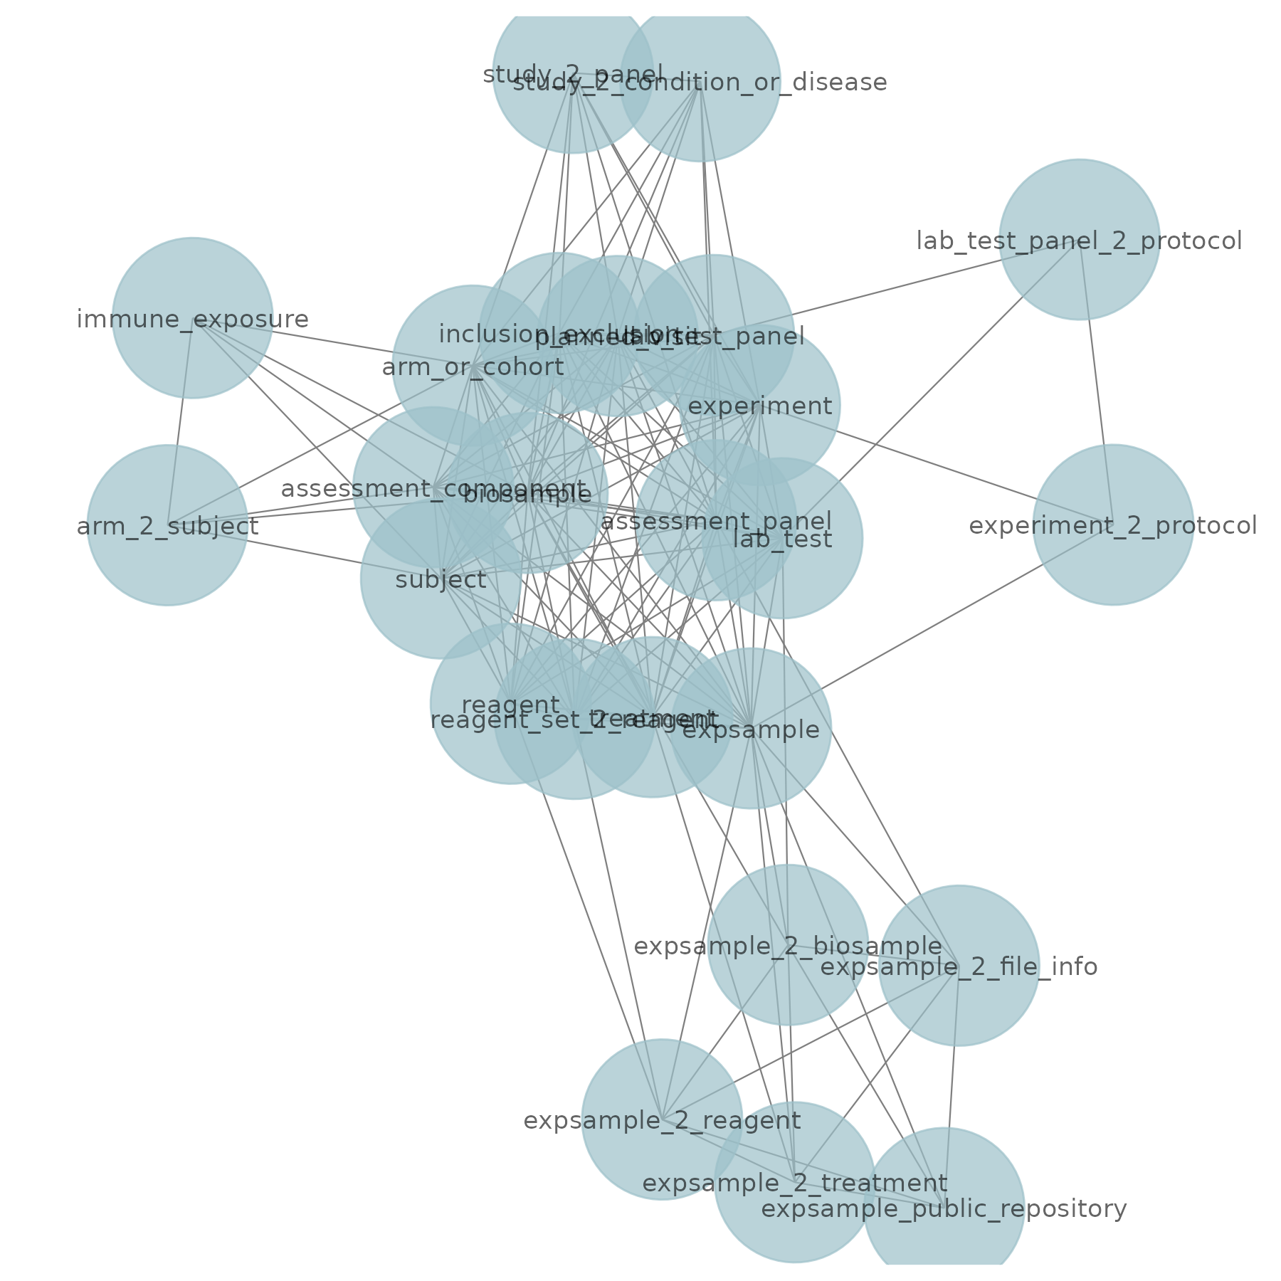
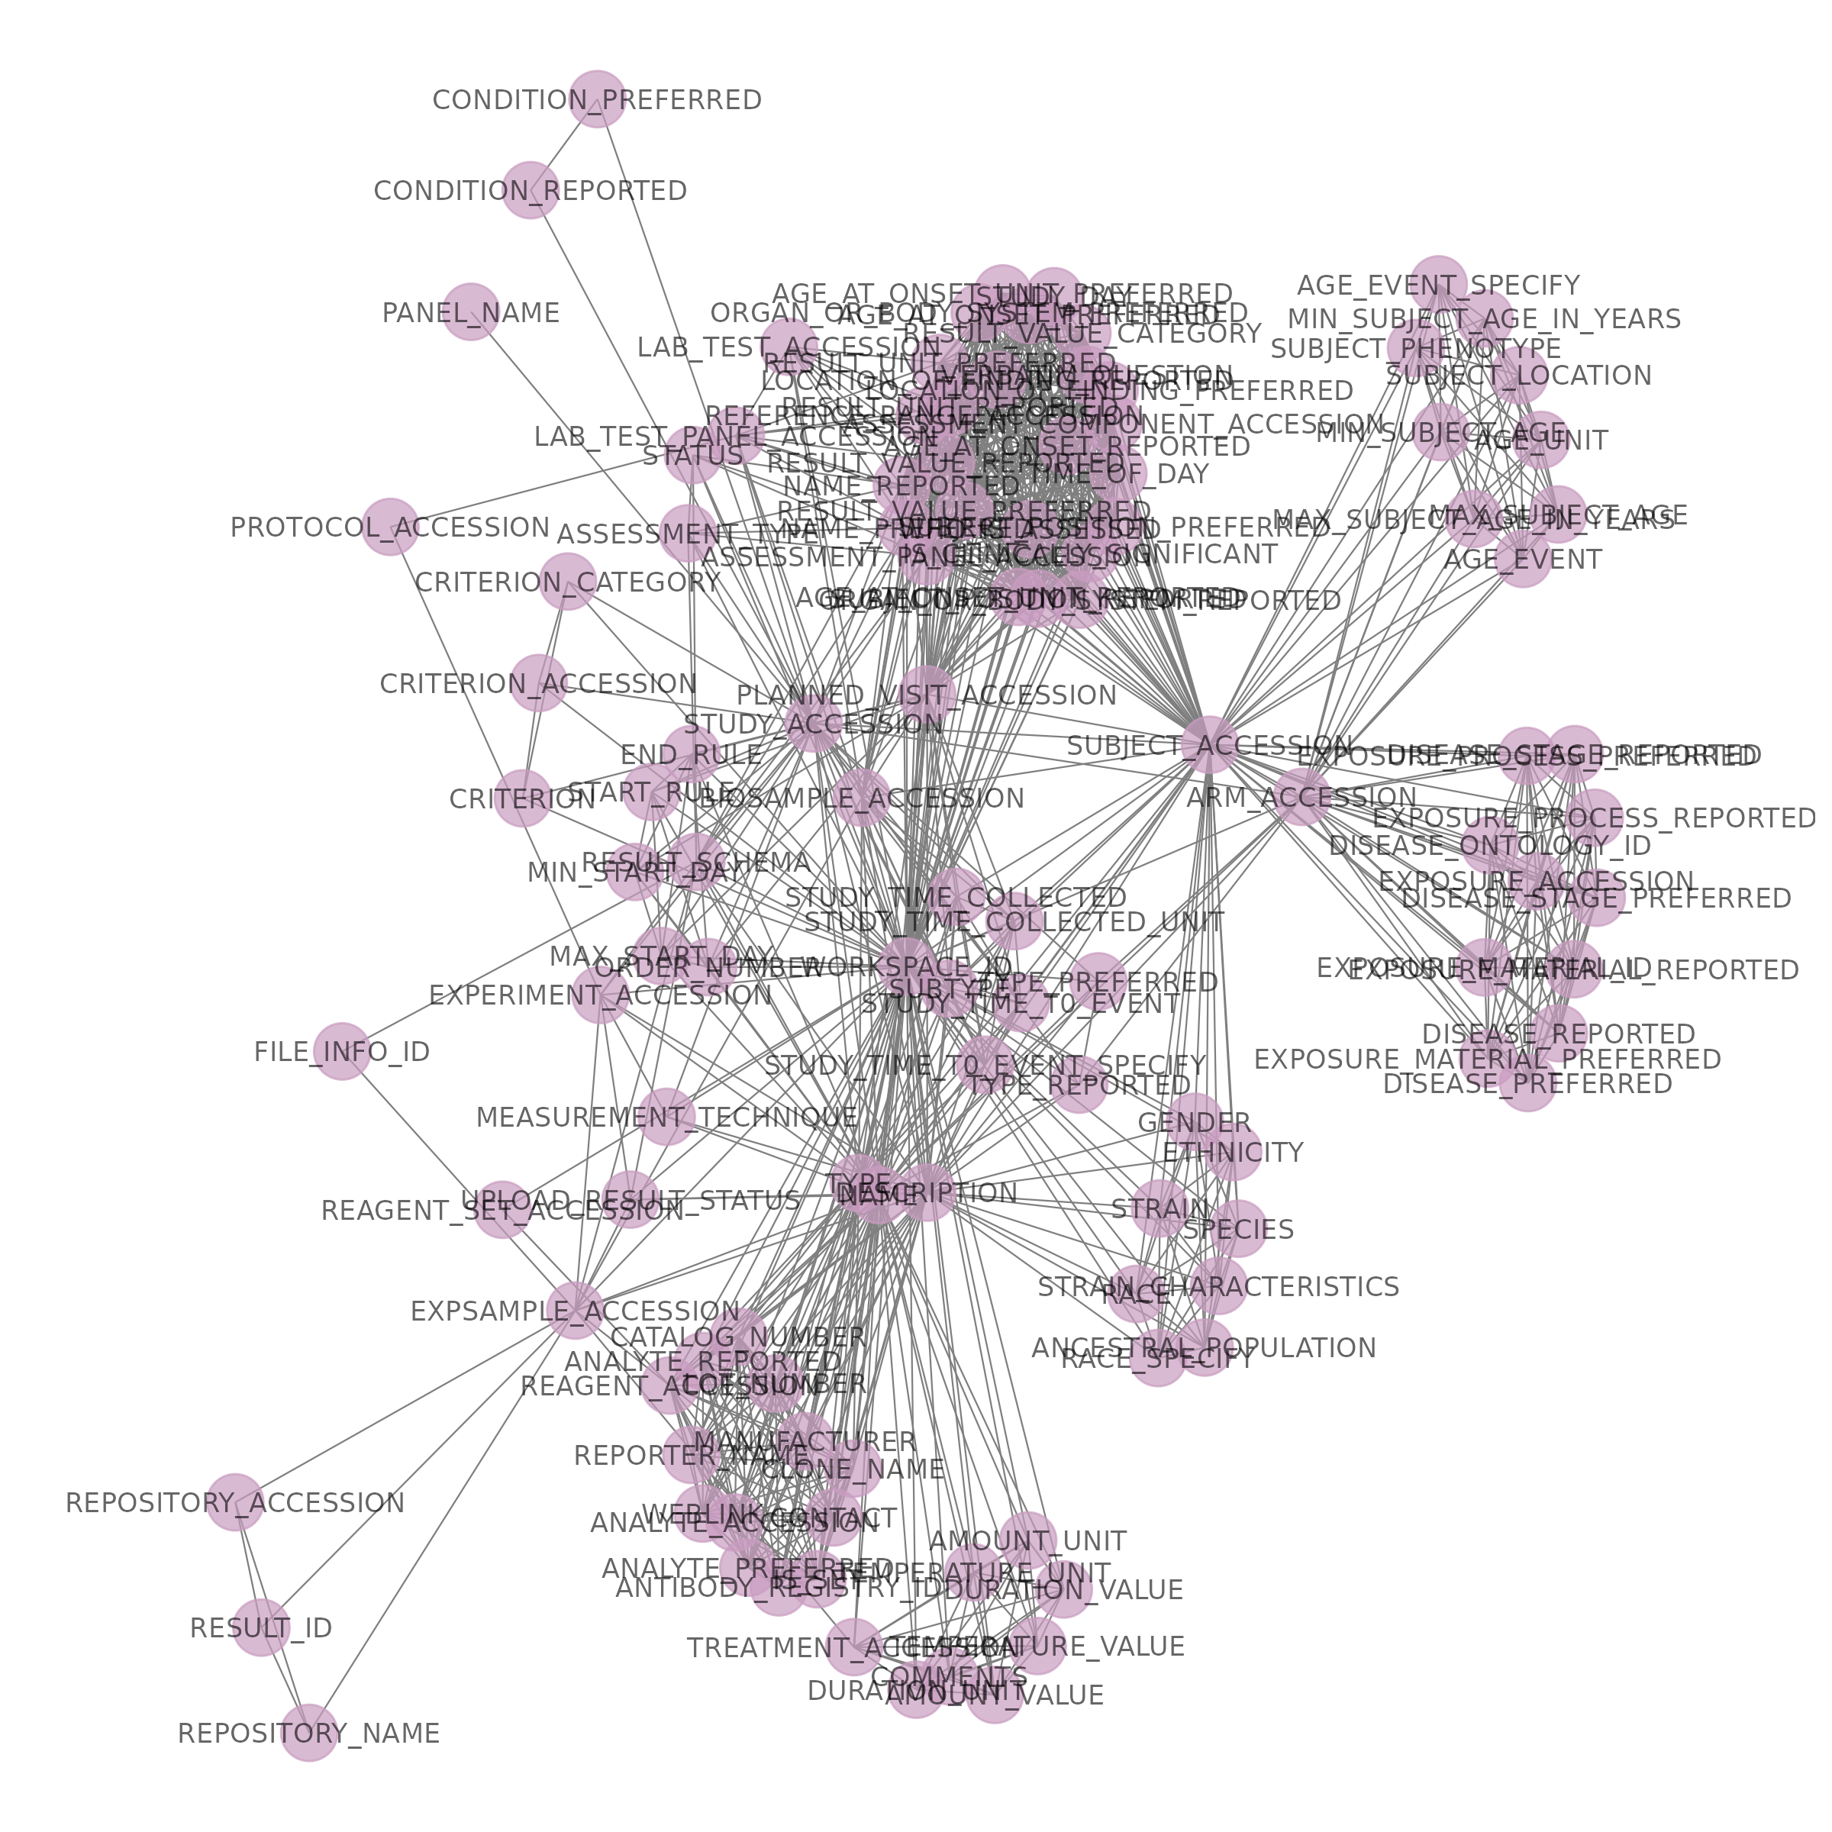
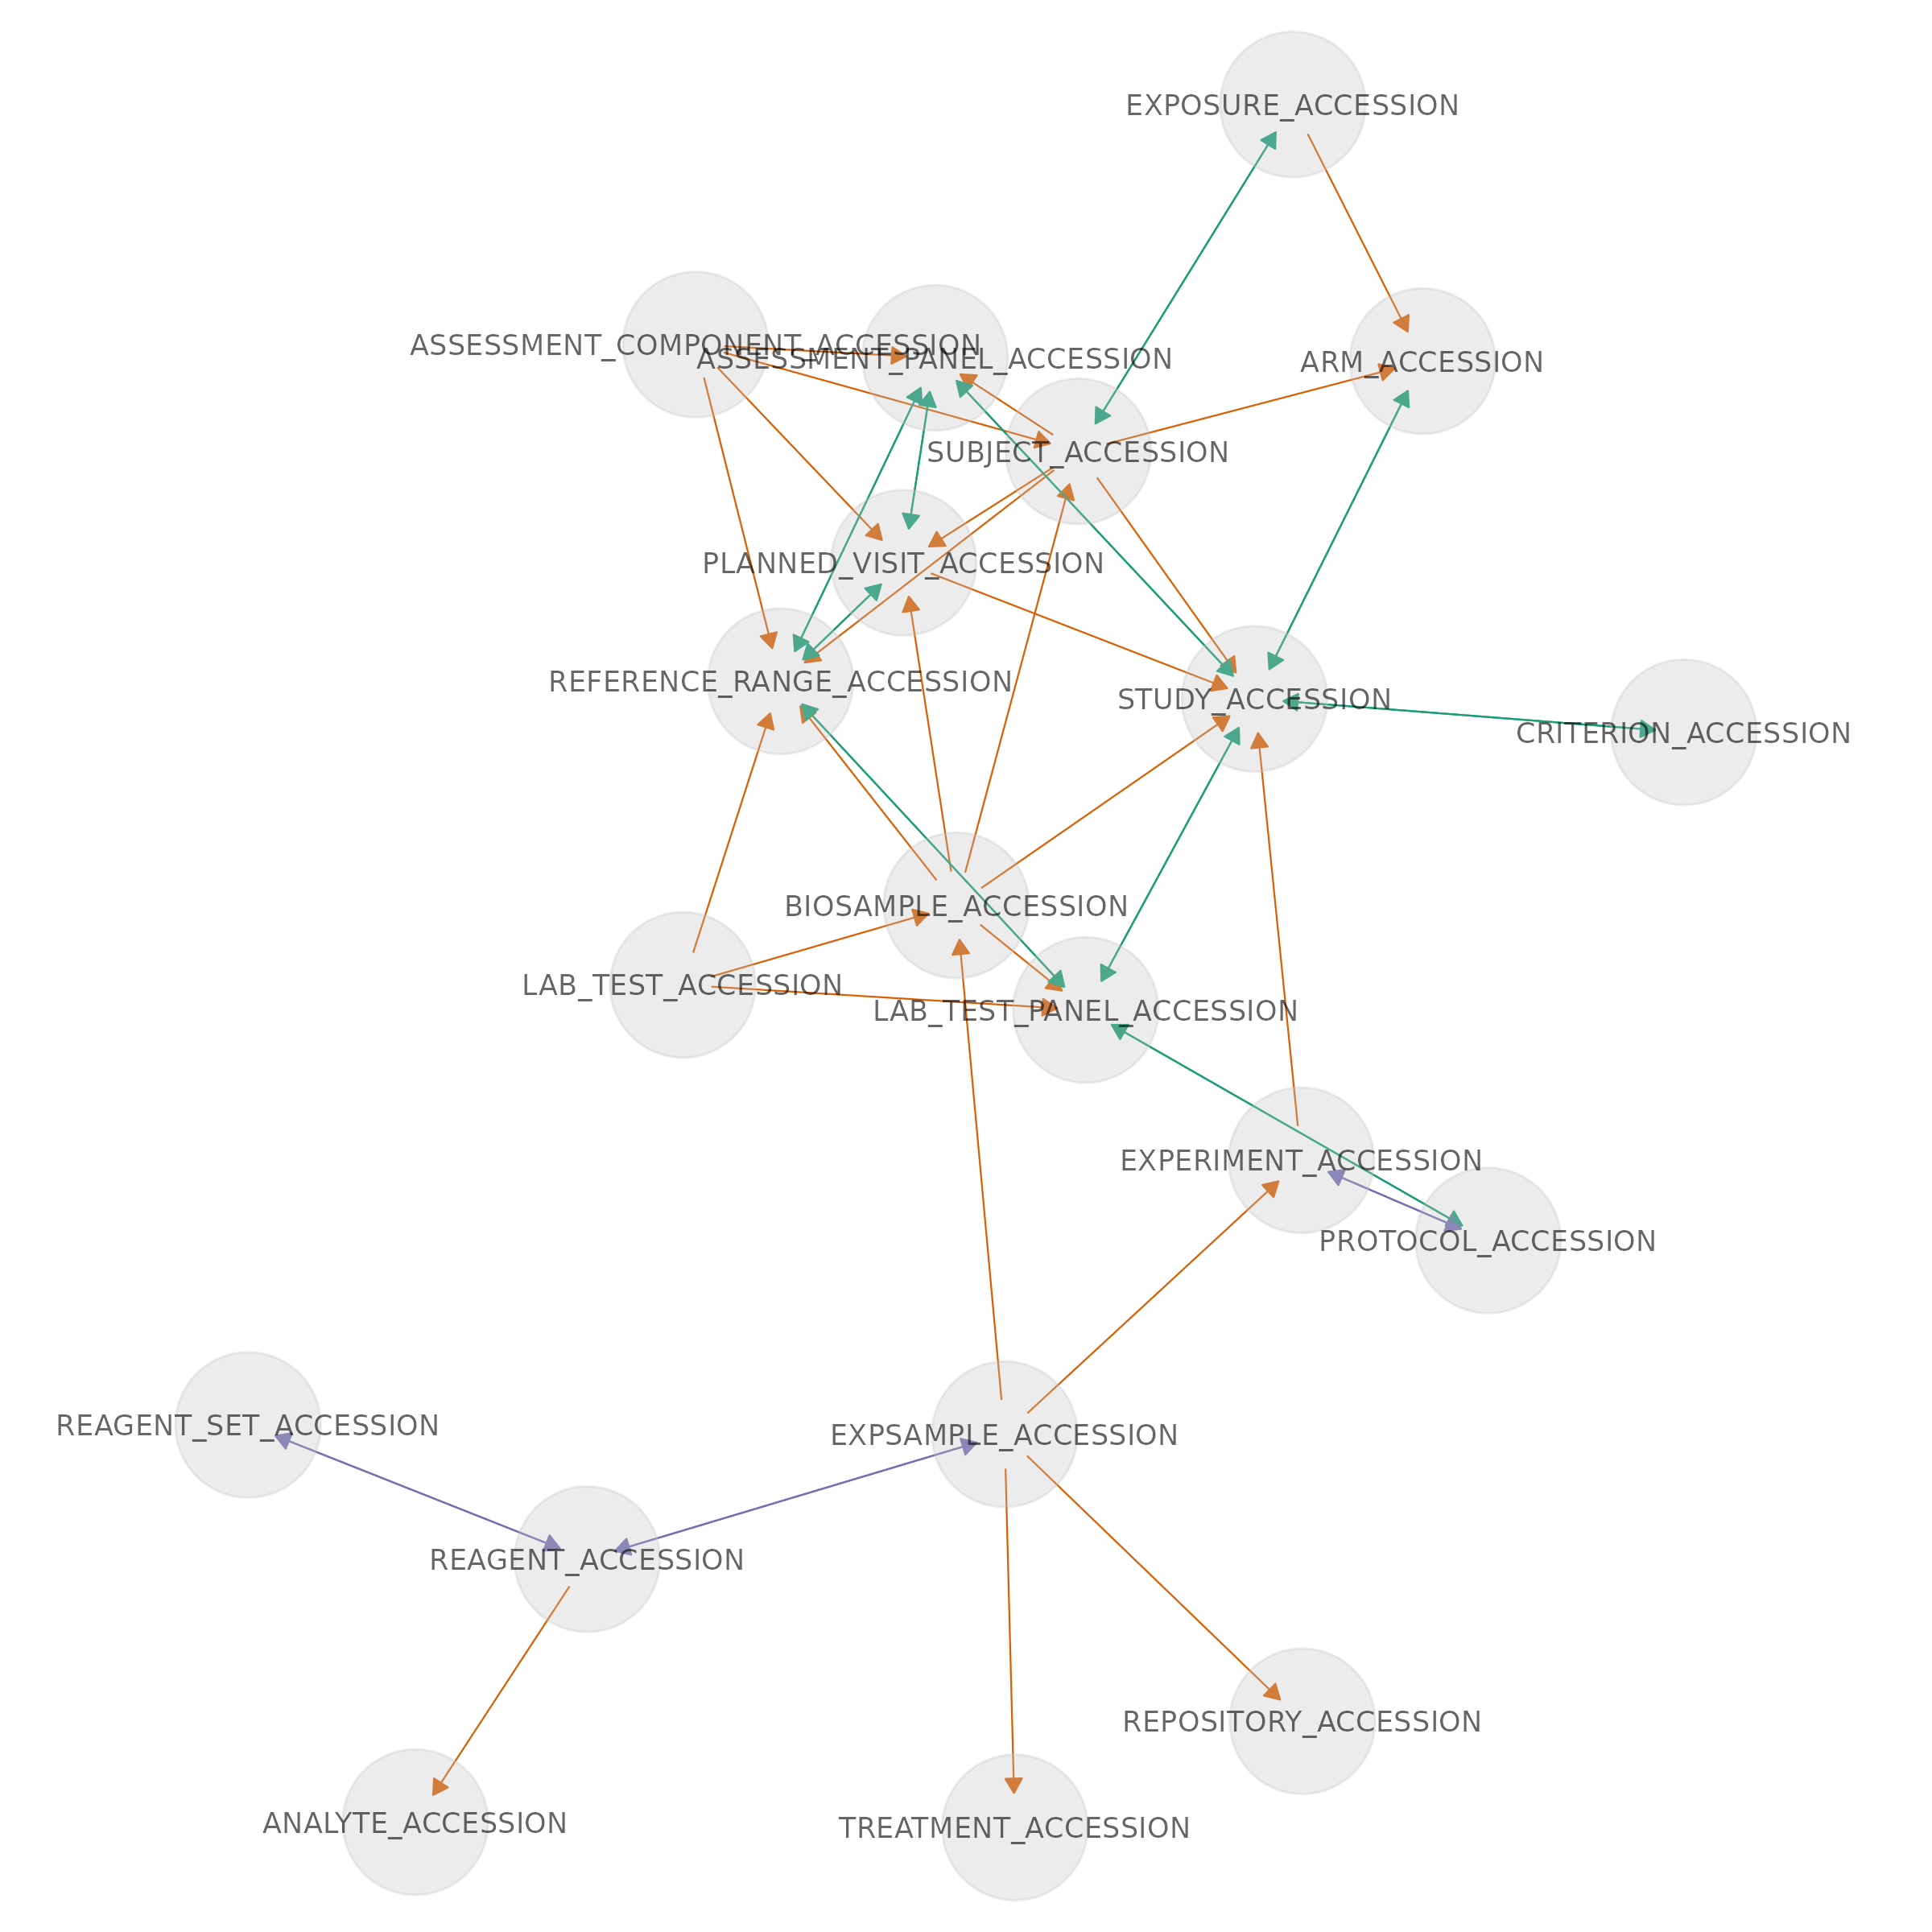
Data exploration

Slide 4
NLM demo

Slide 5
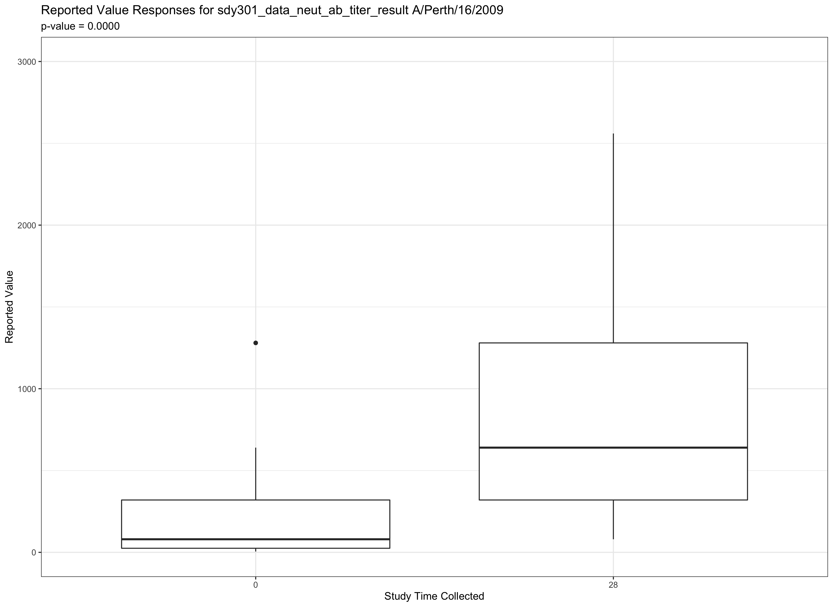
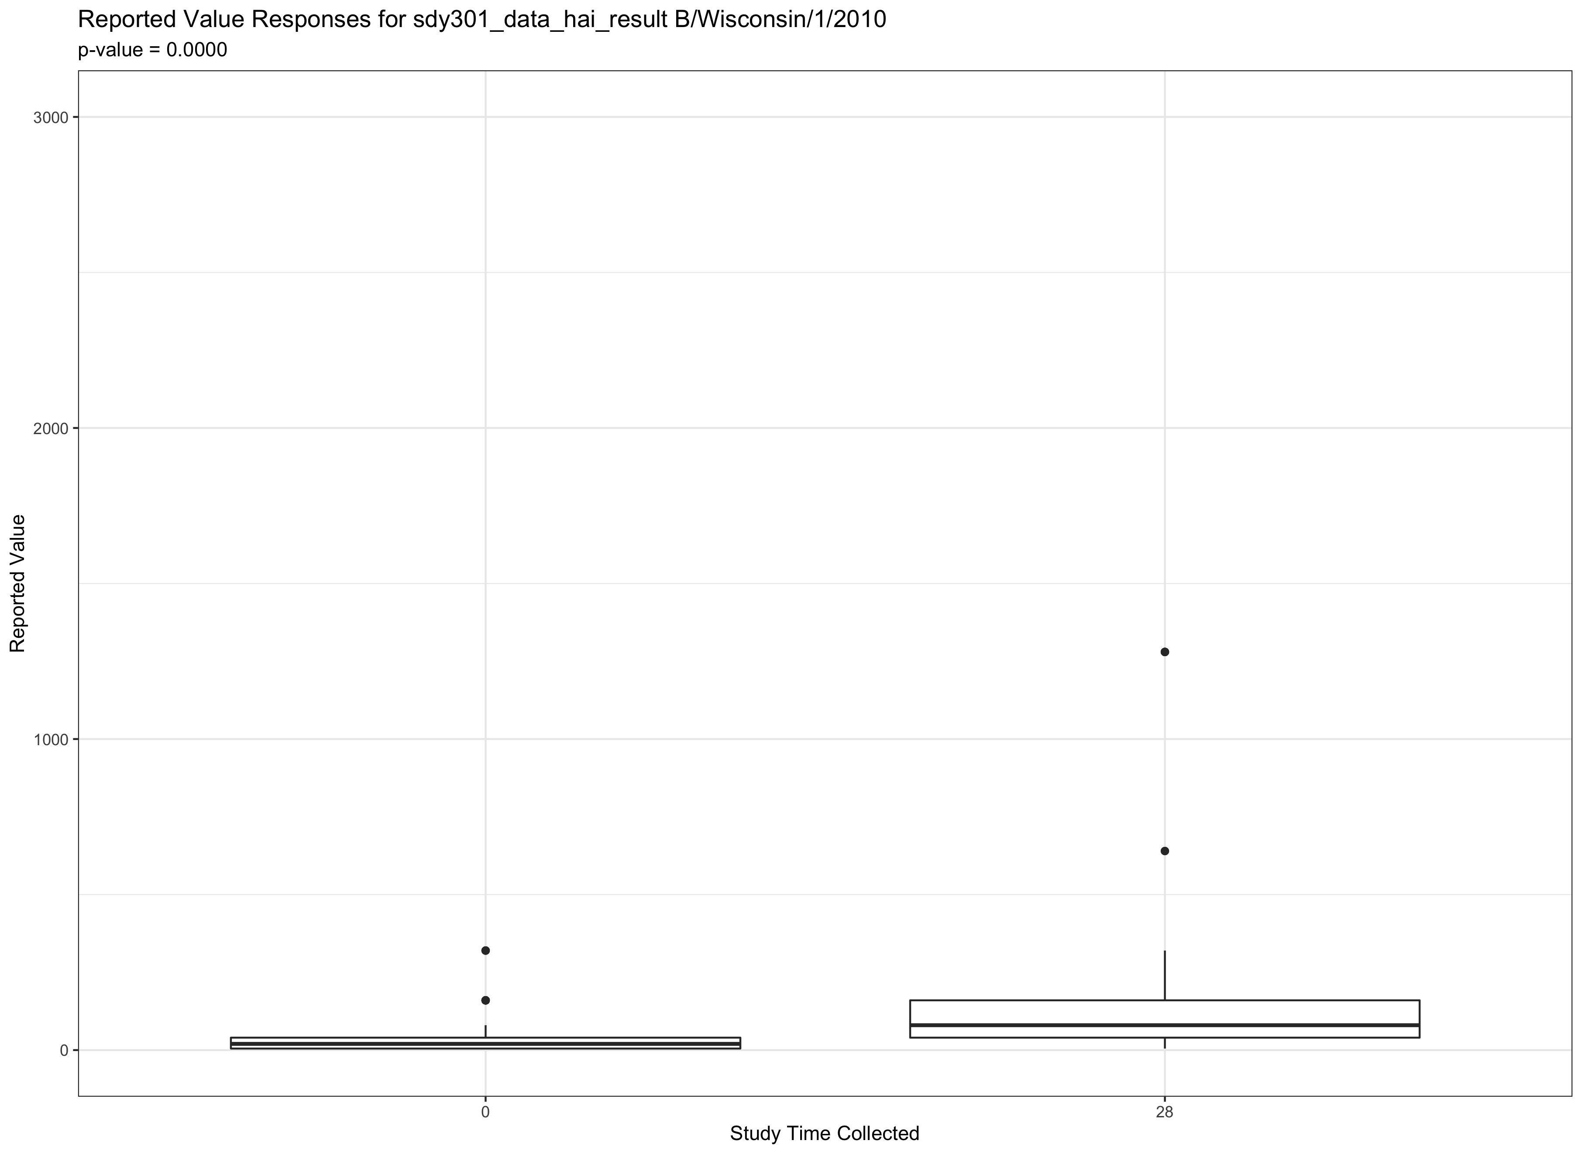
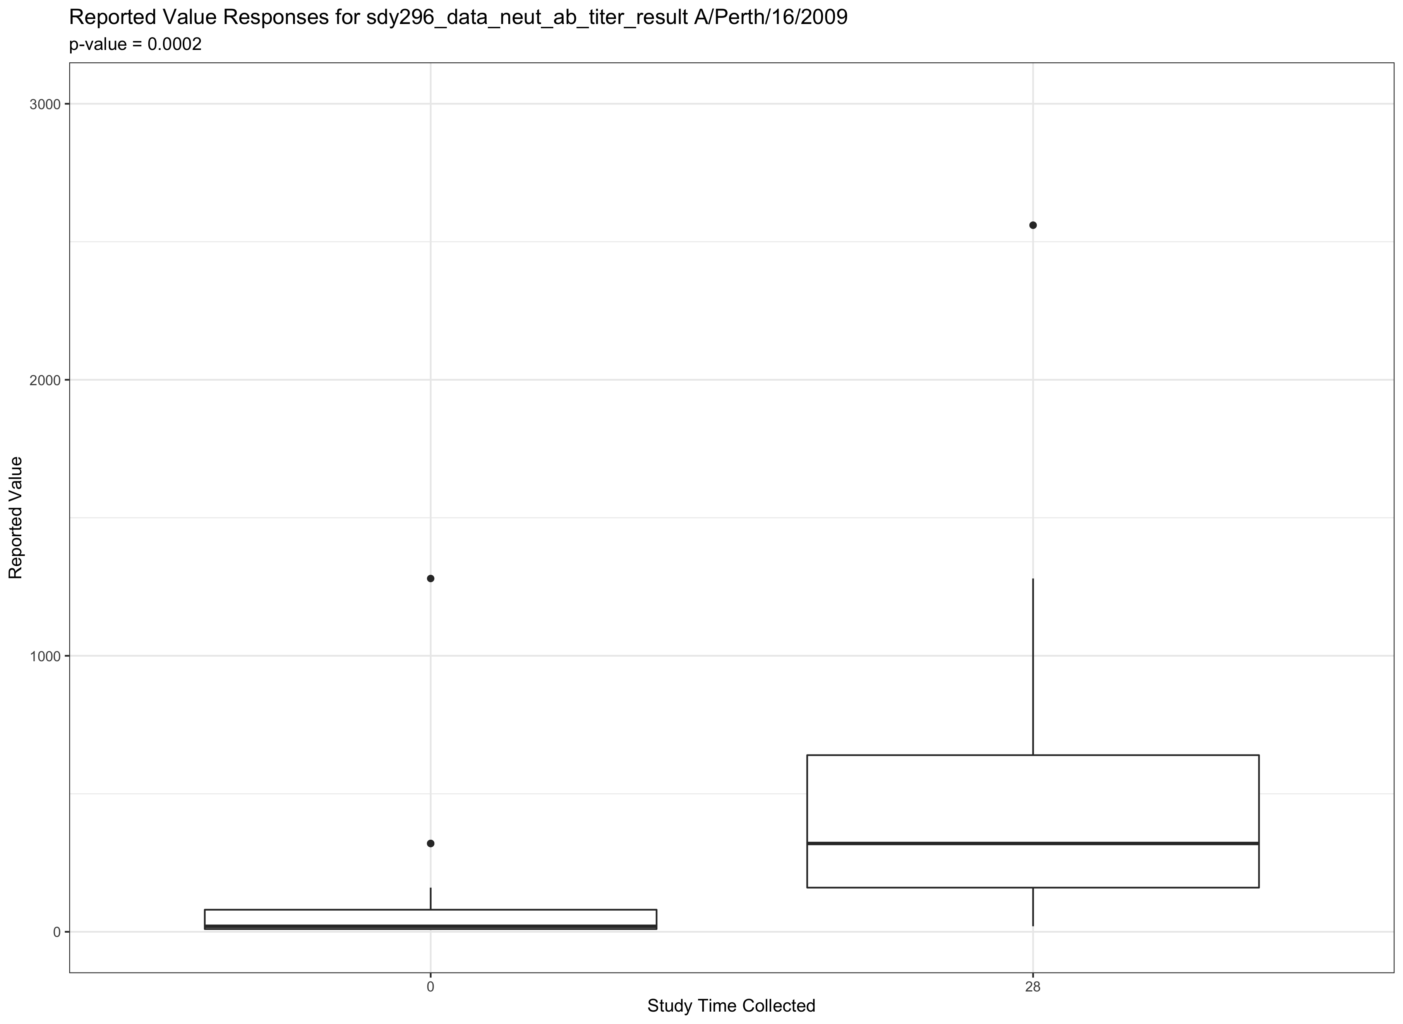
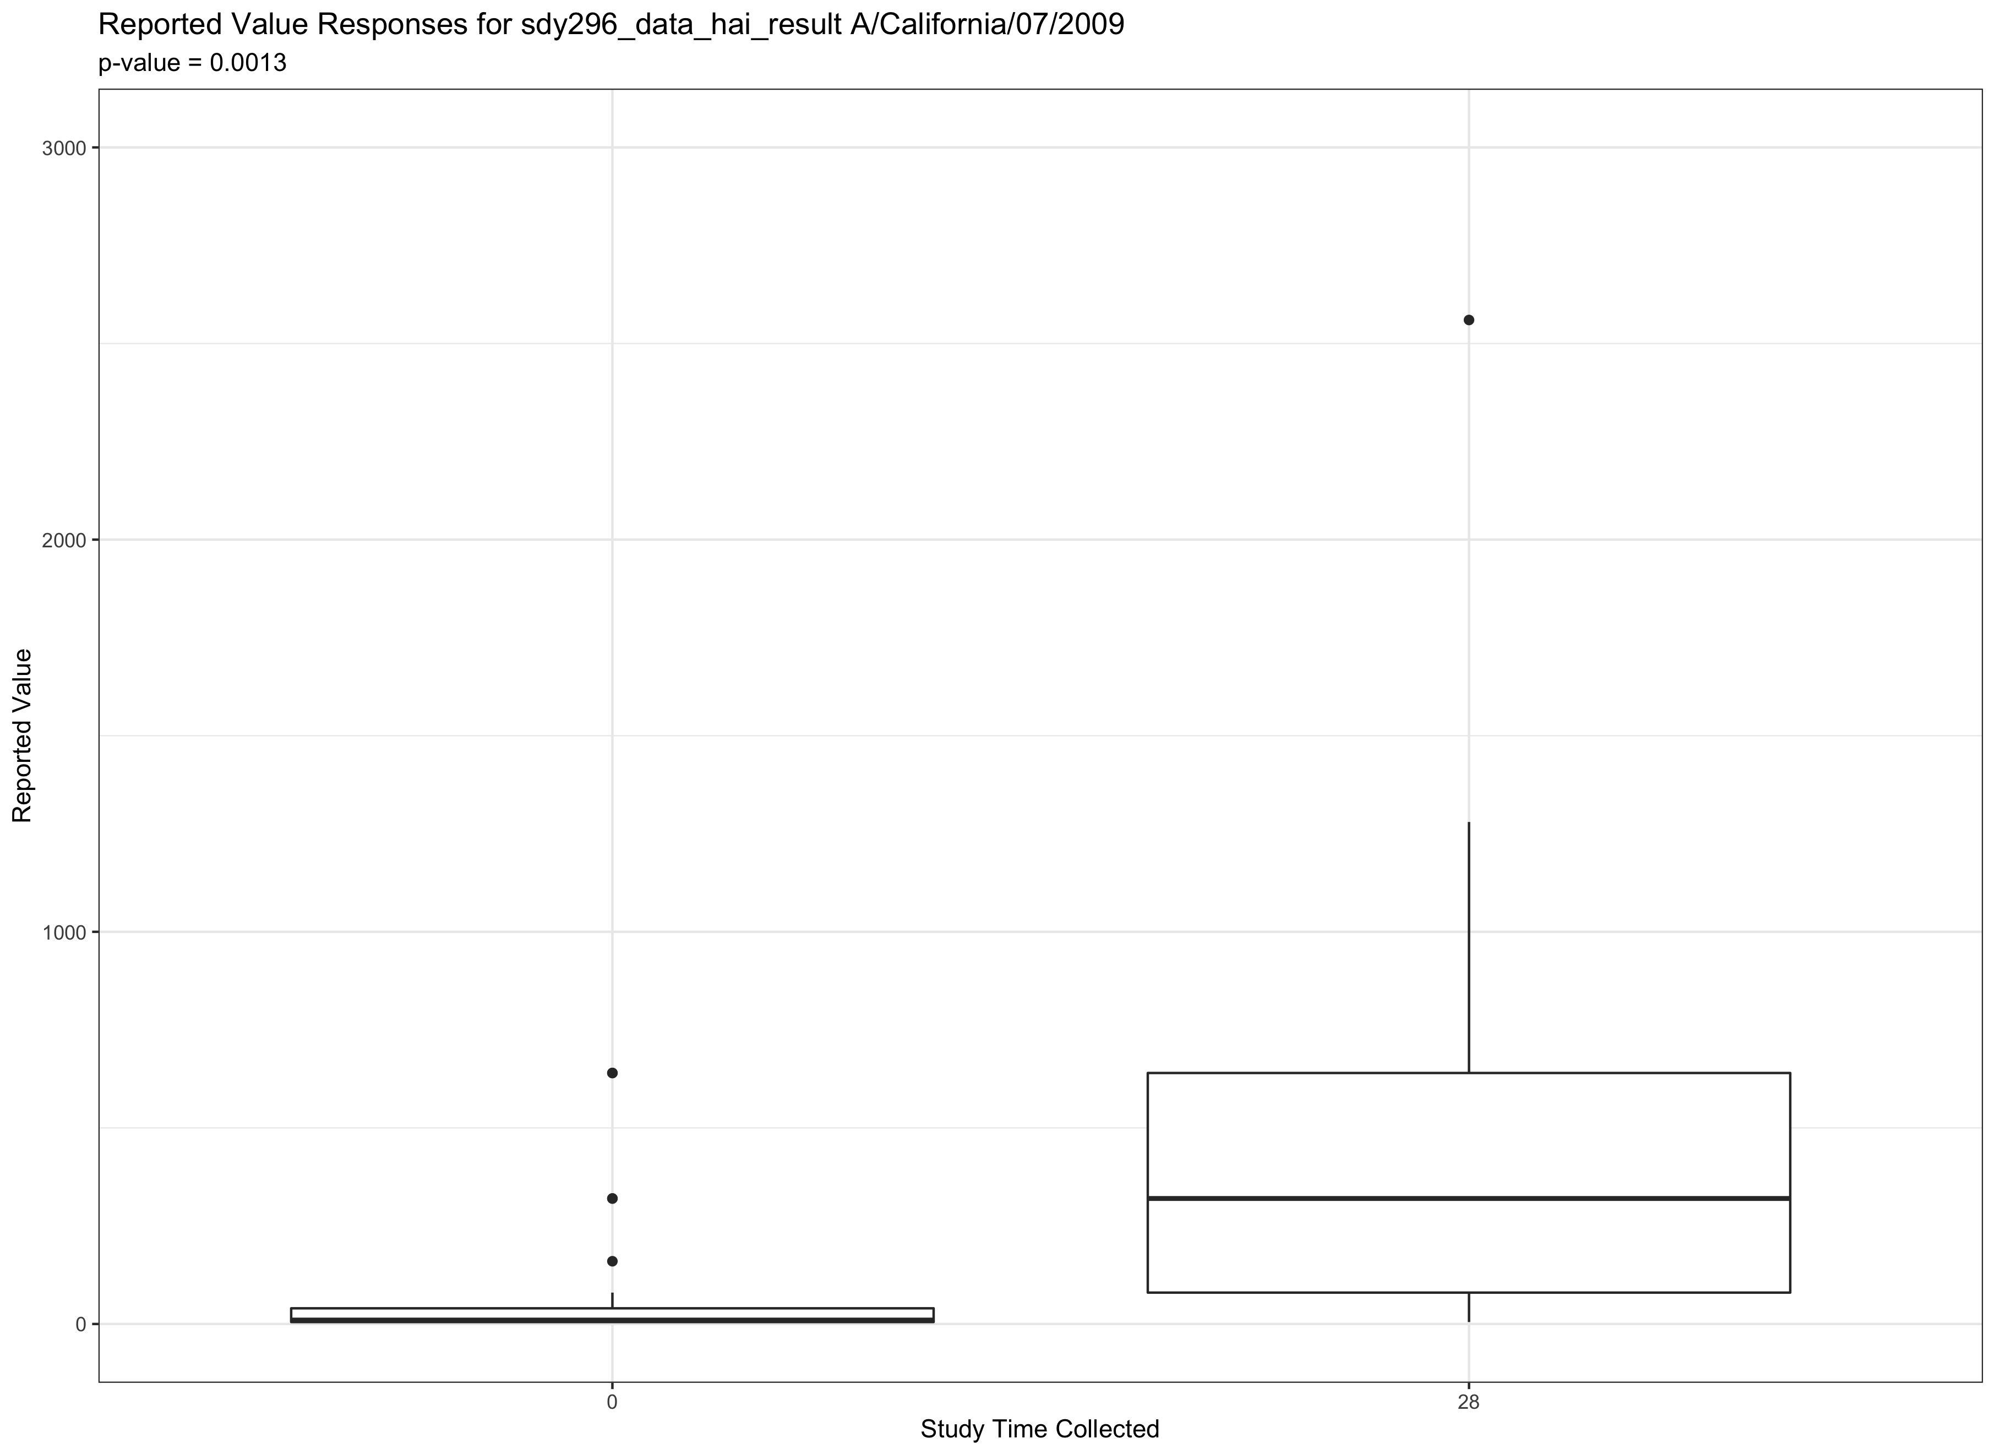
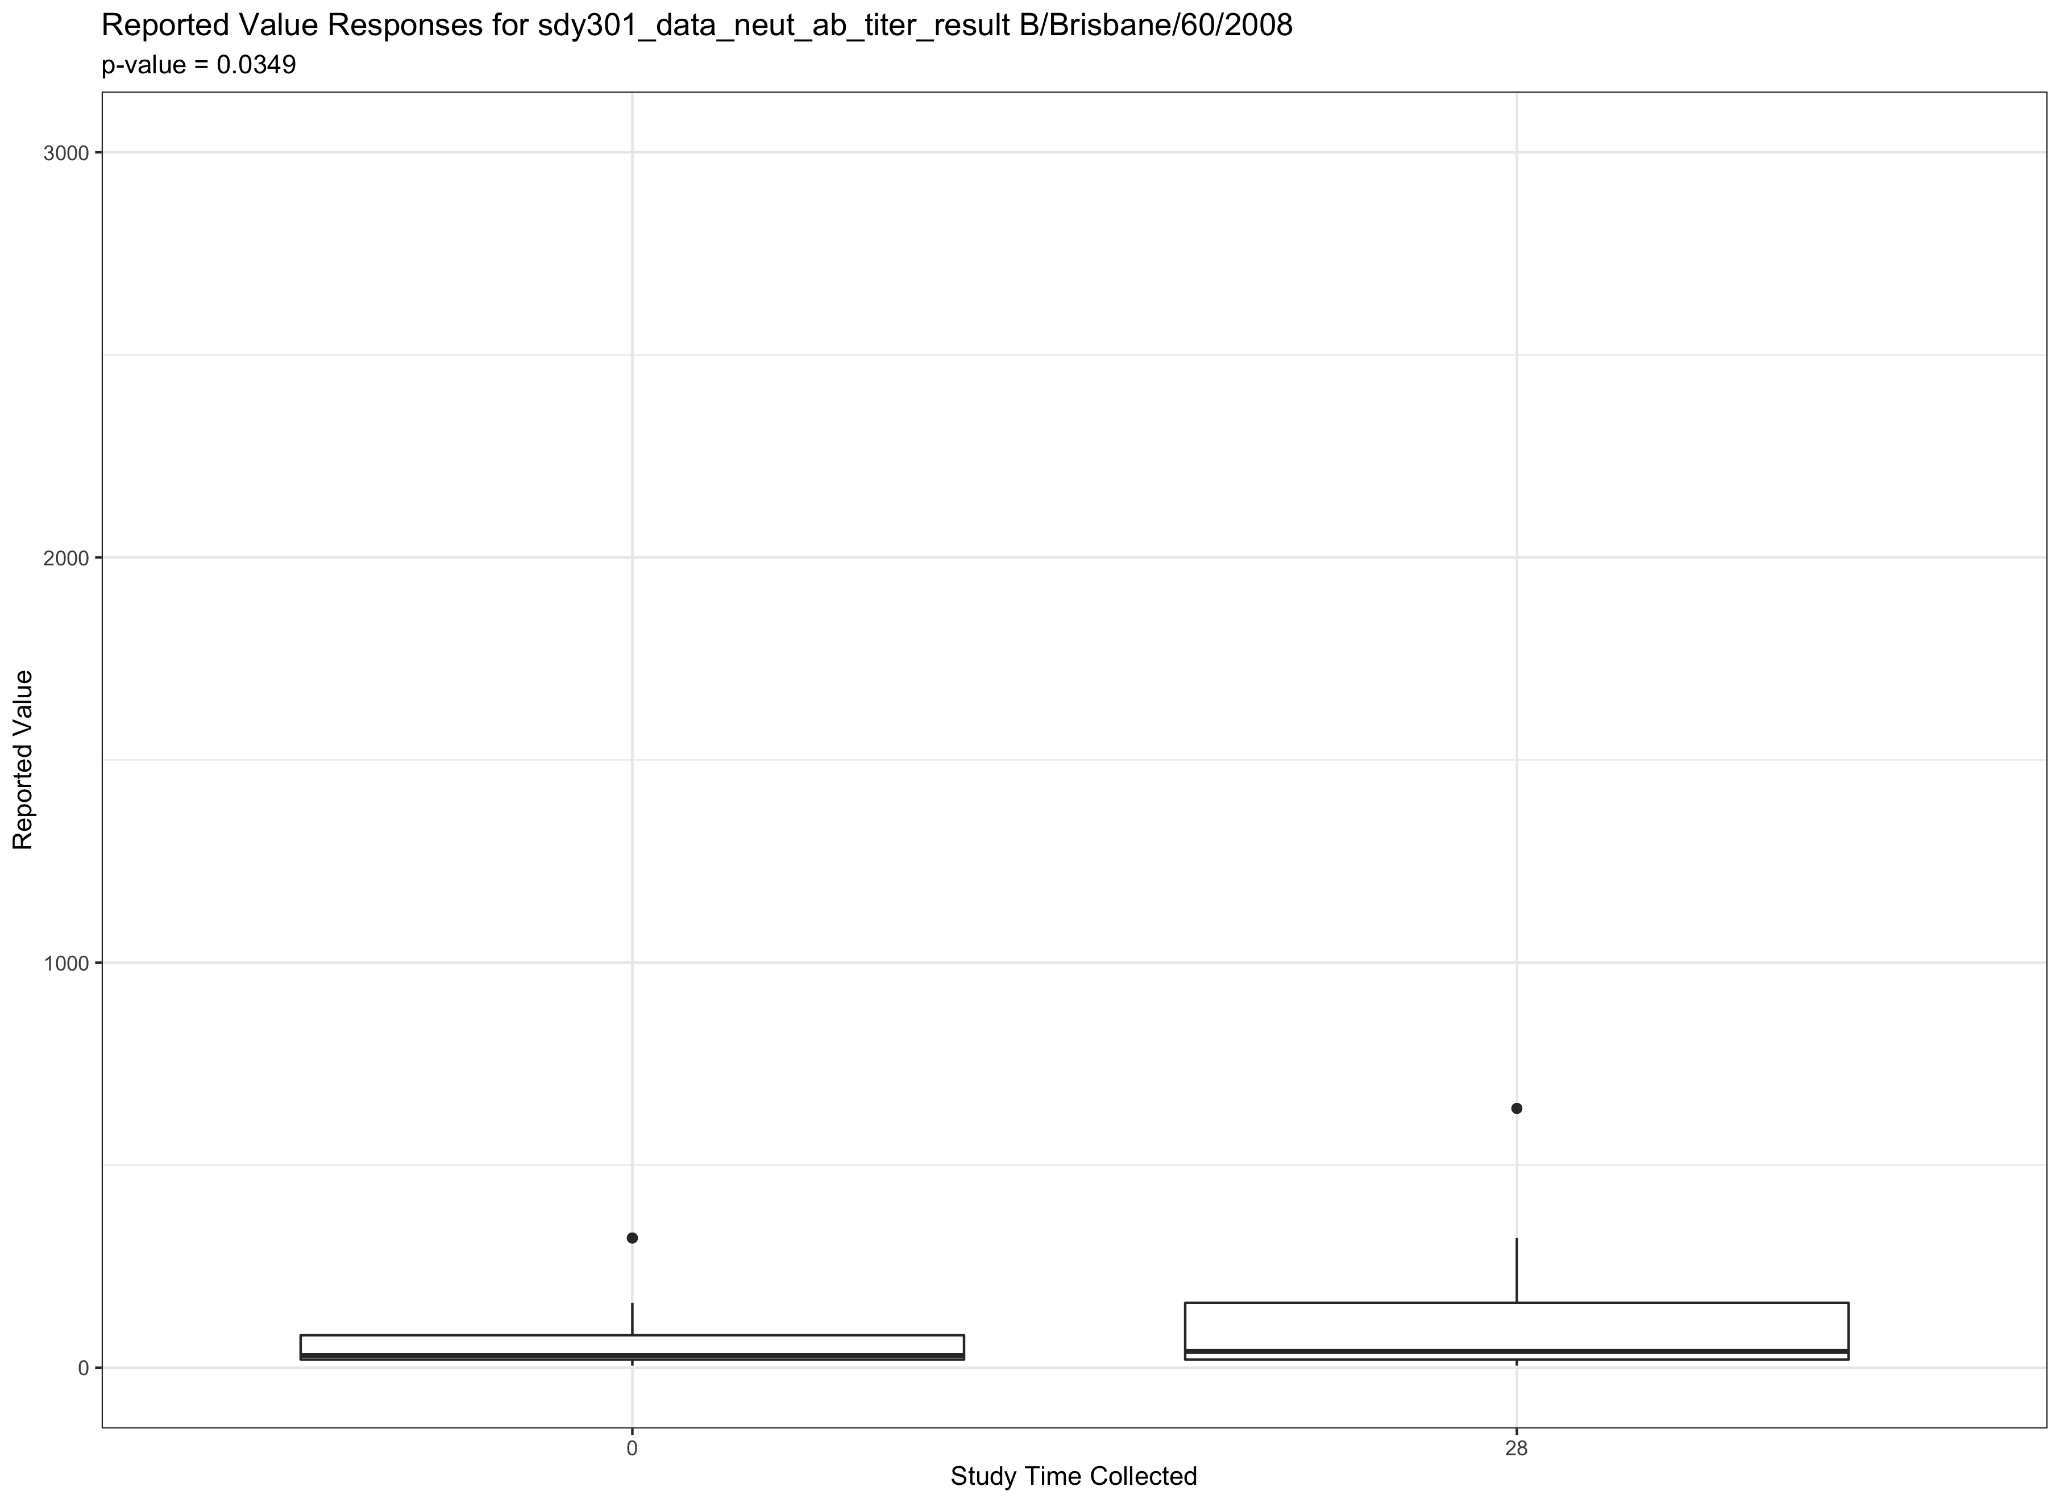
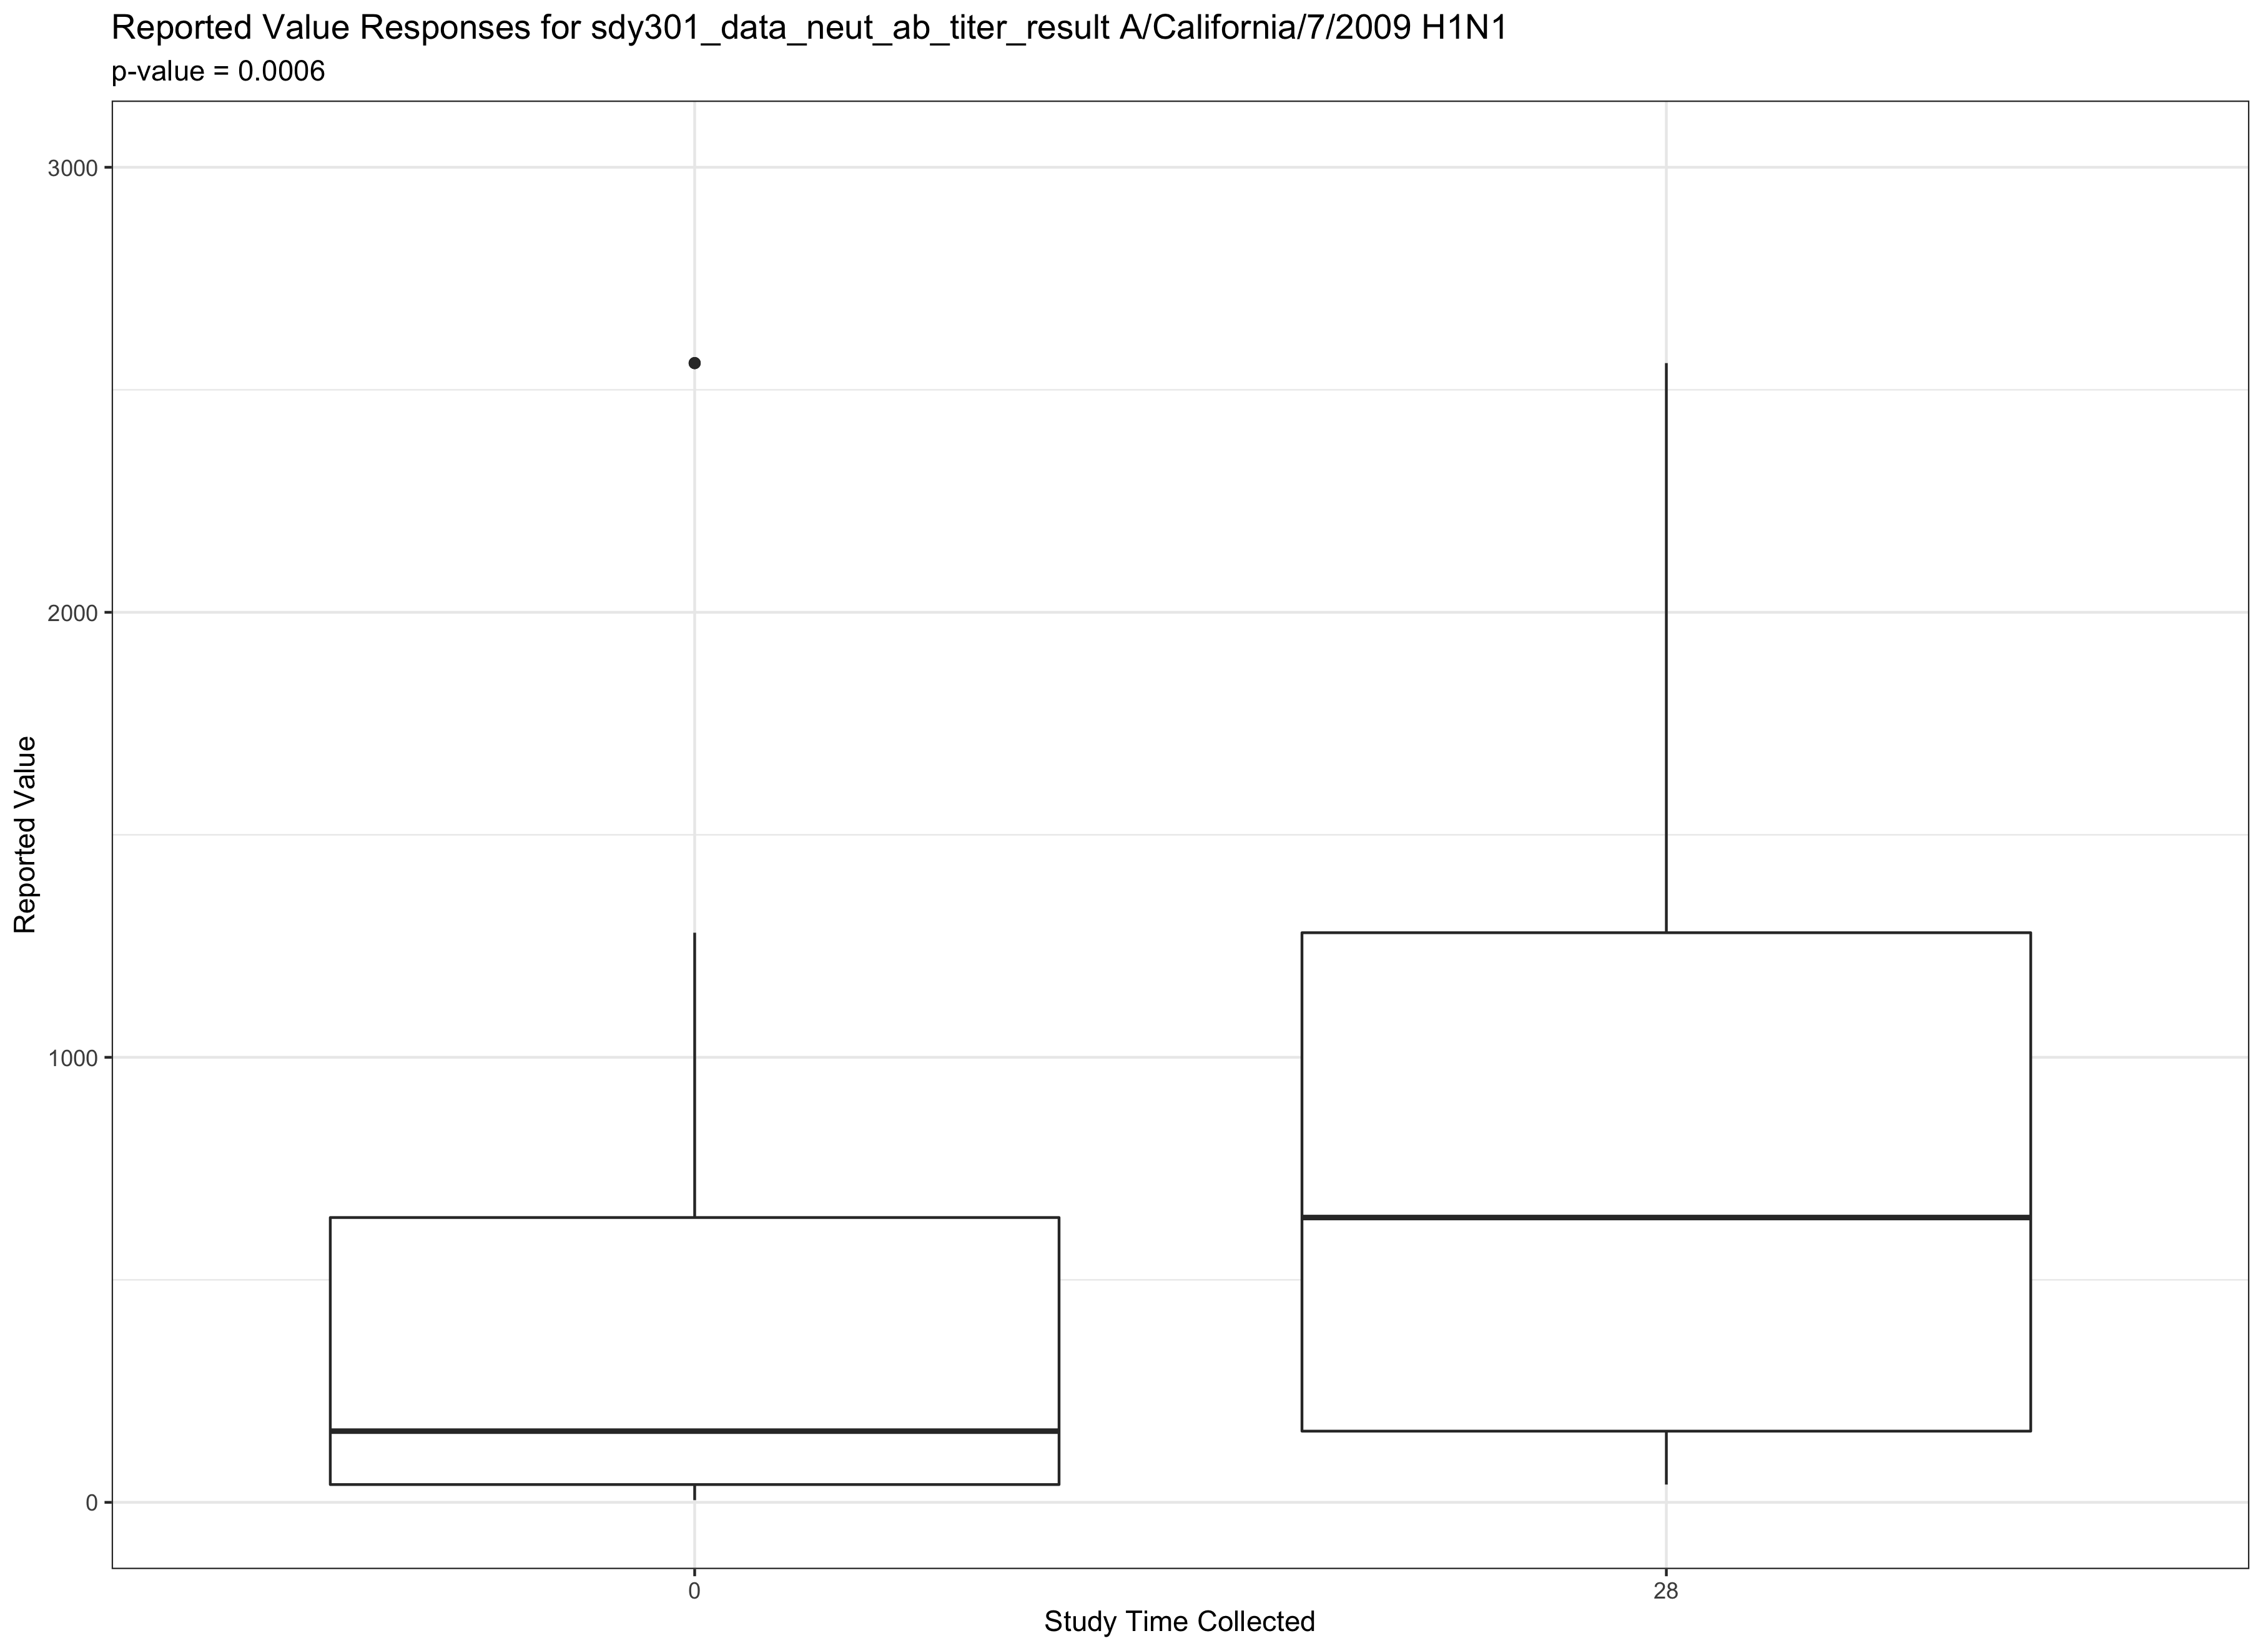
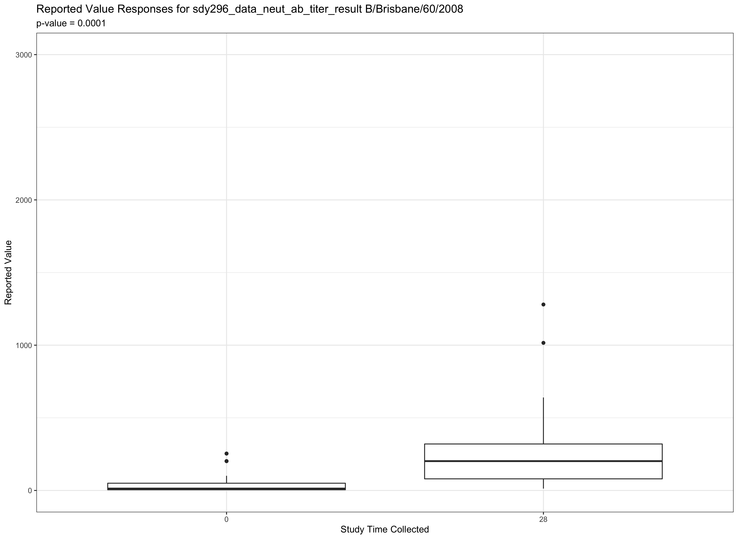

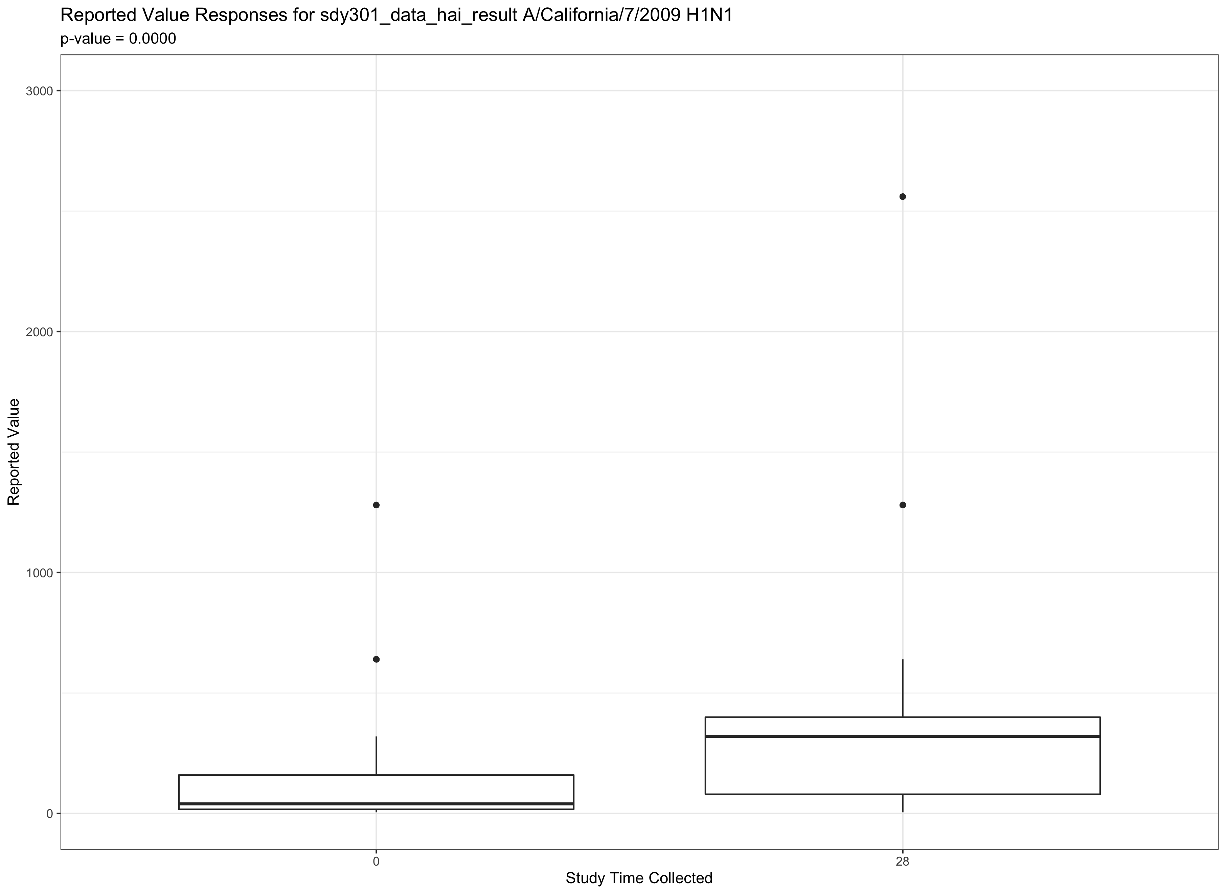
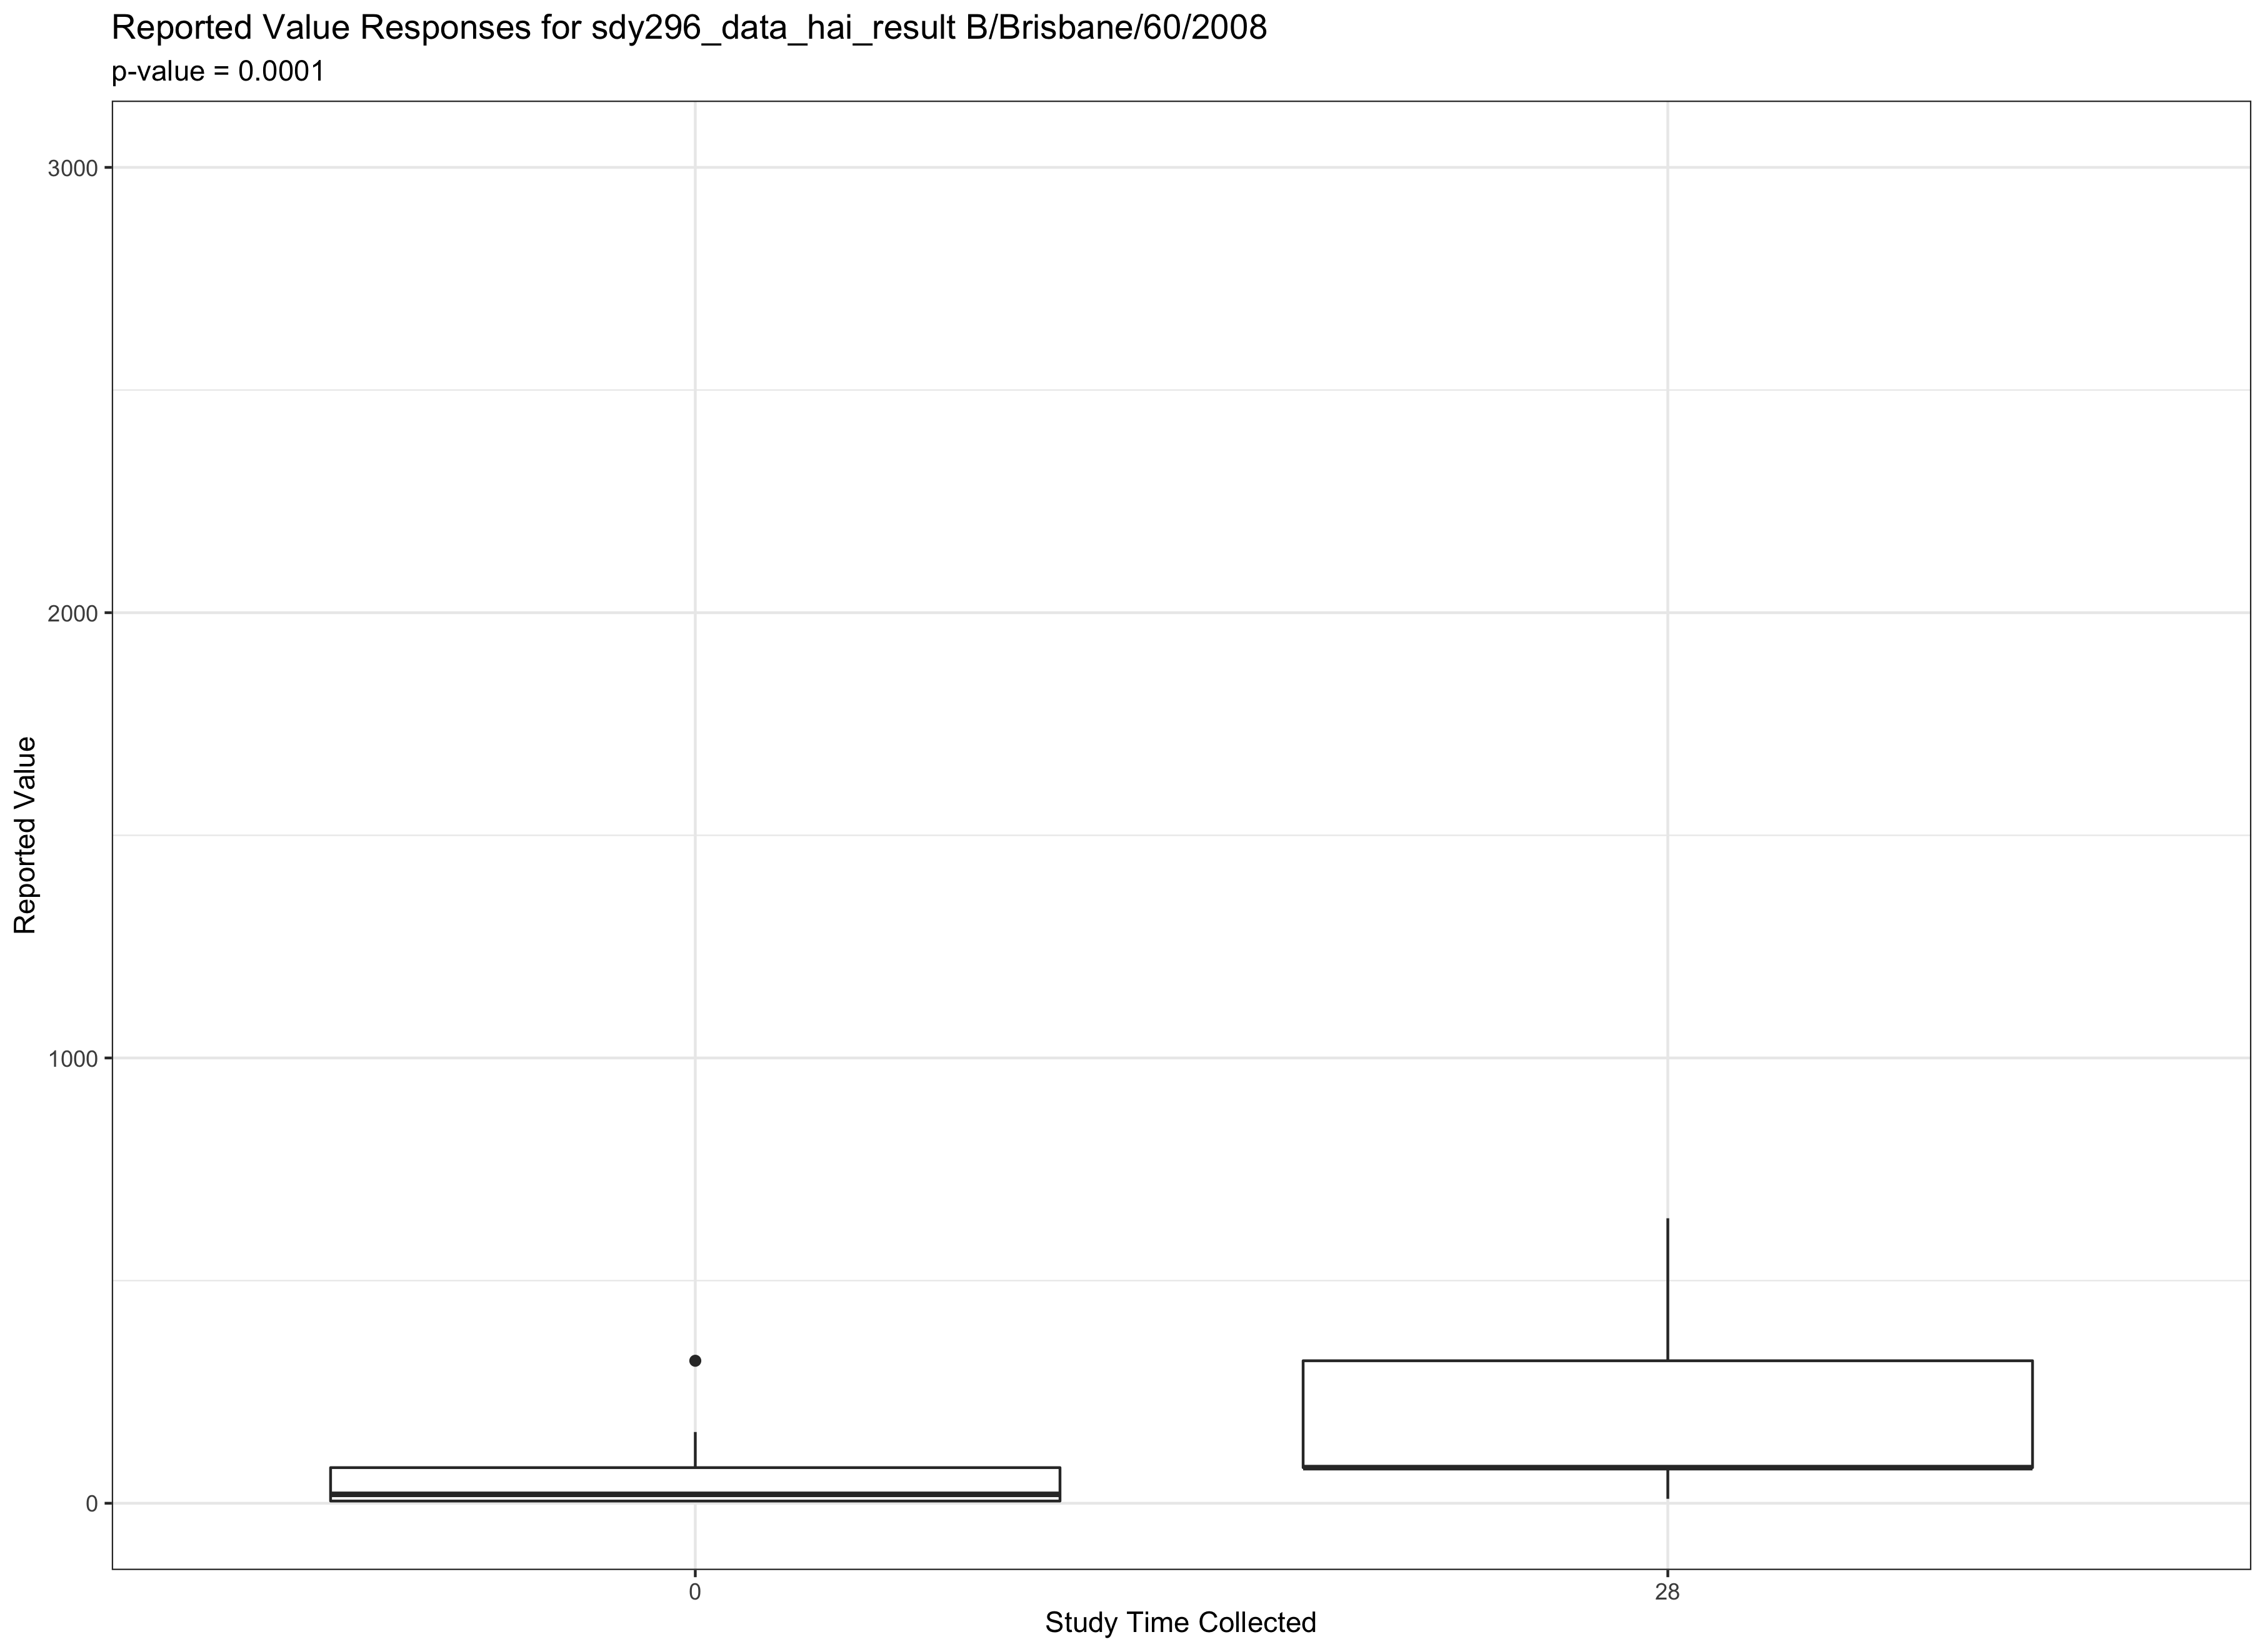
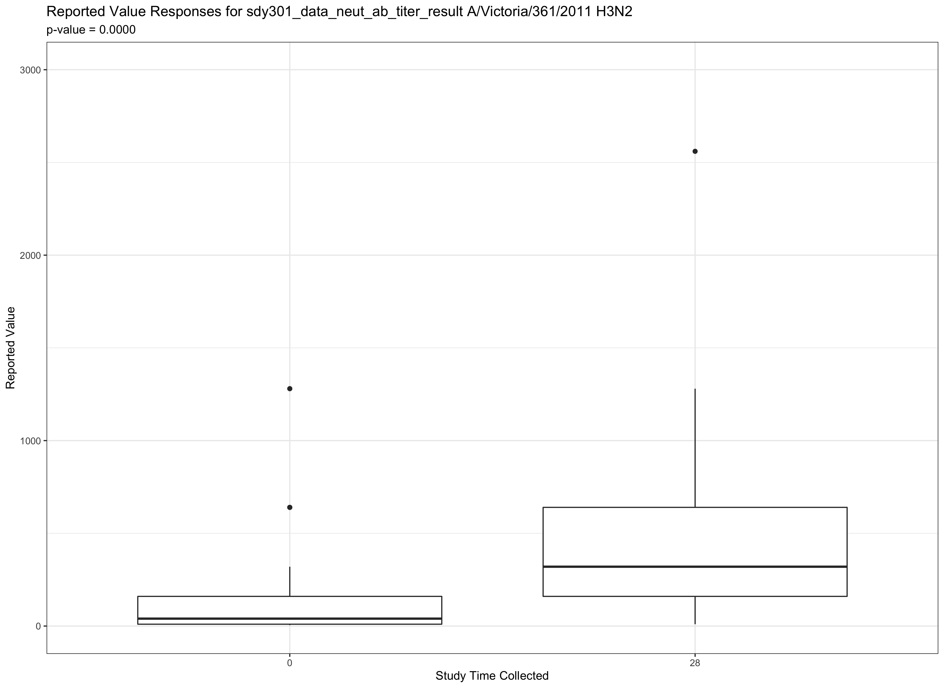
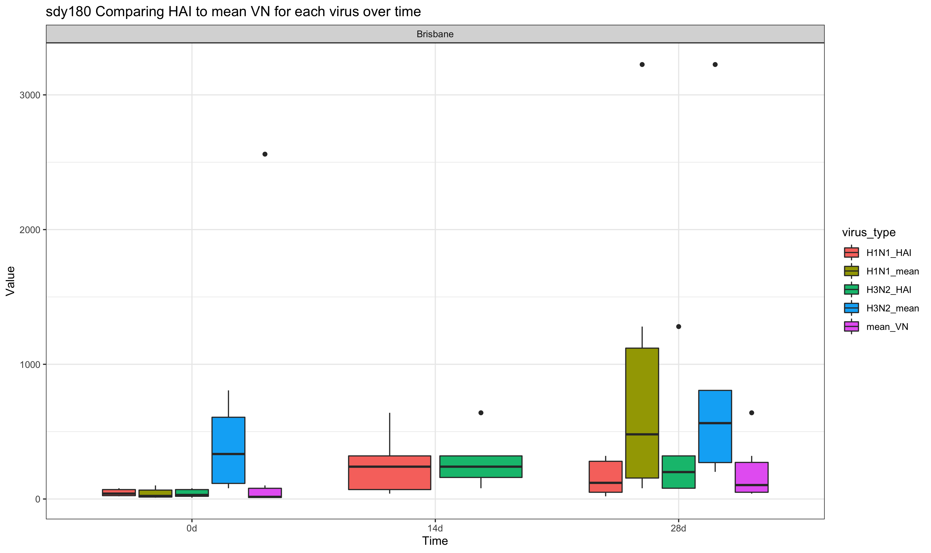
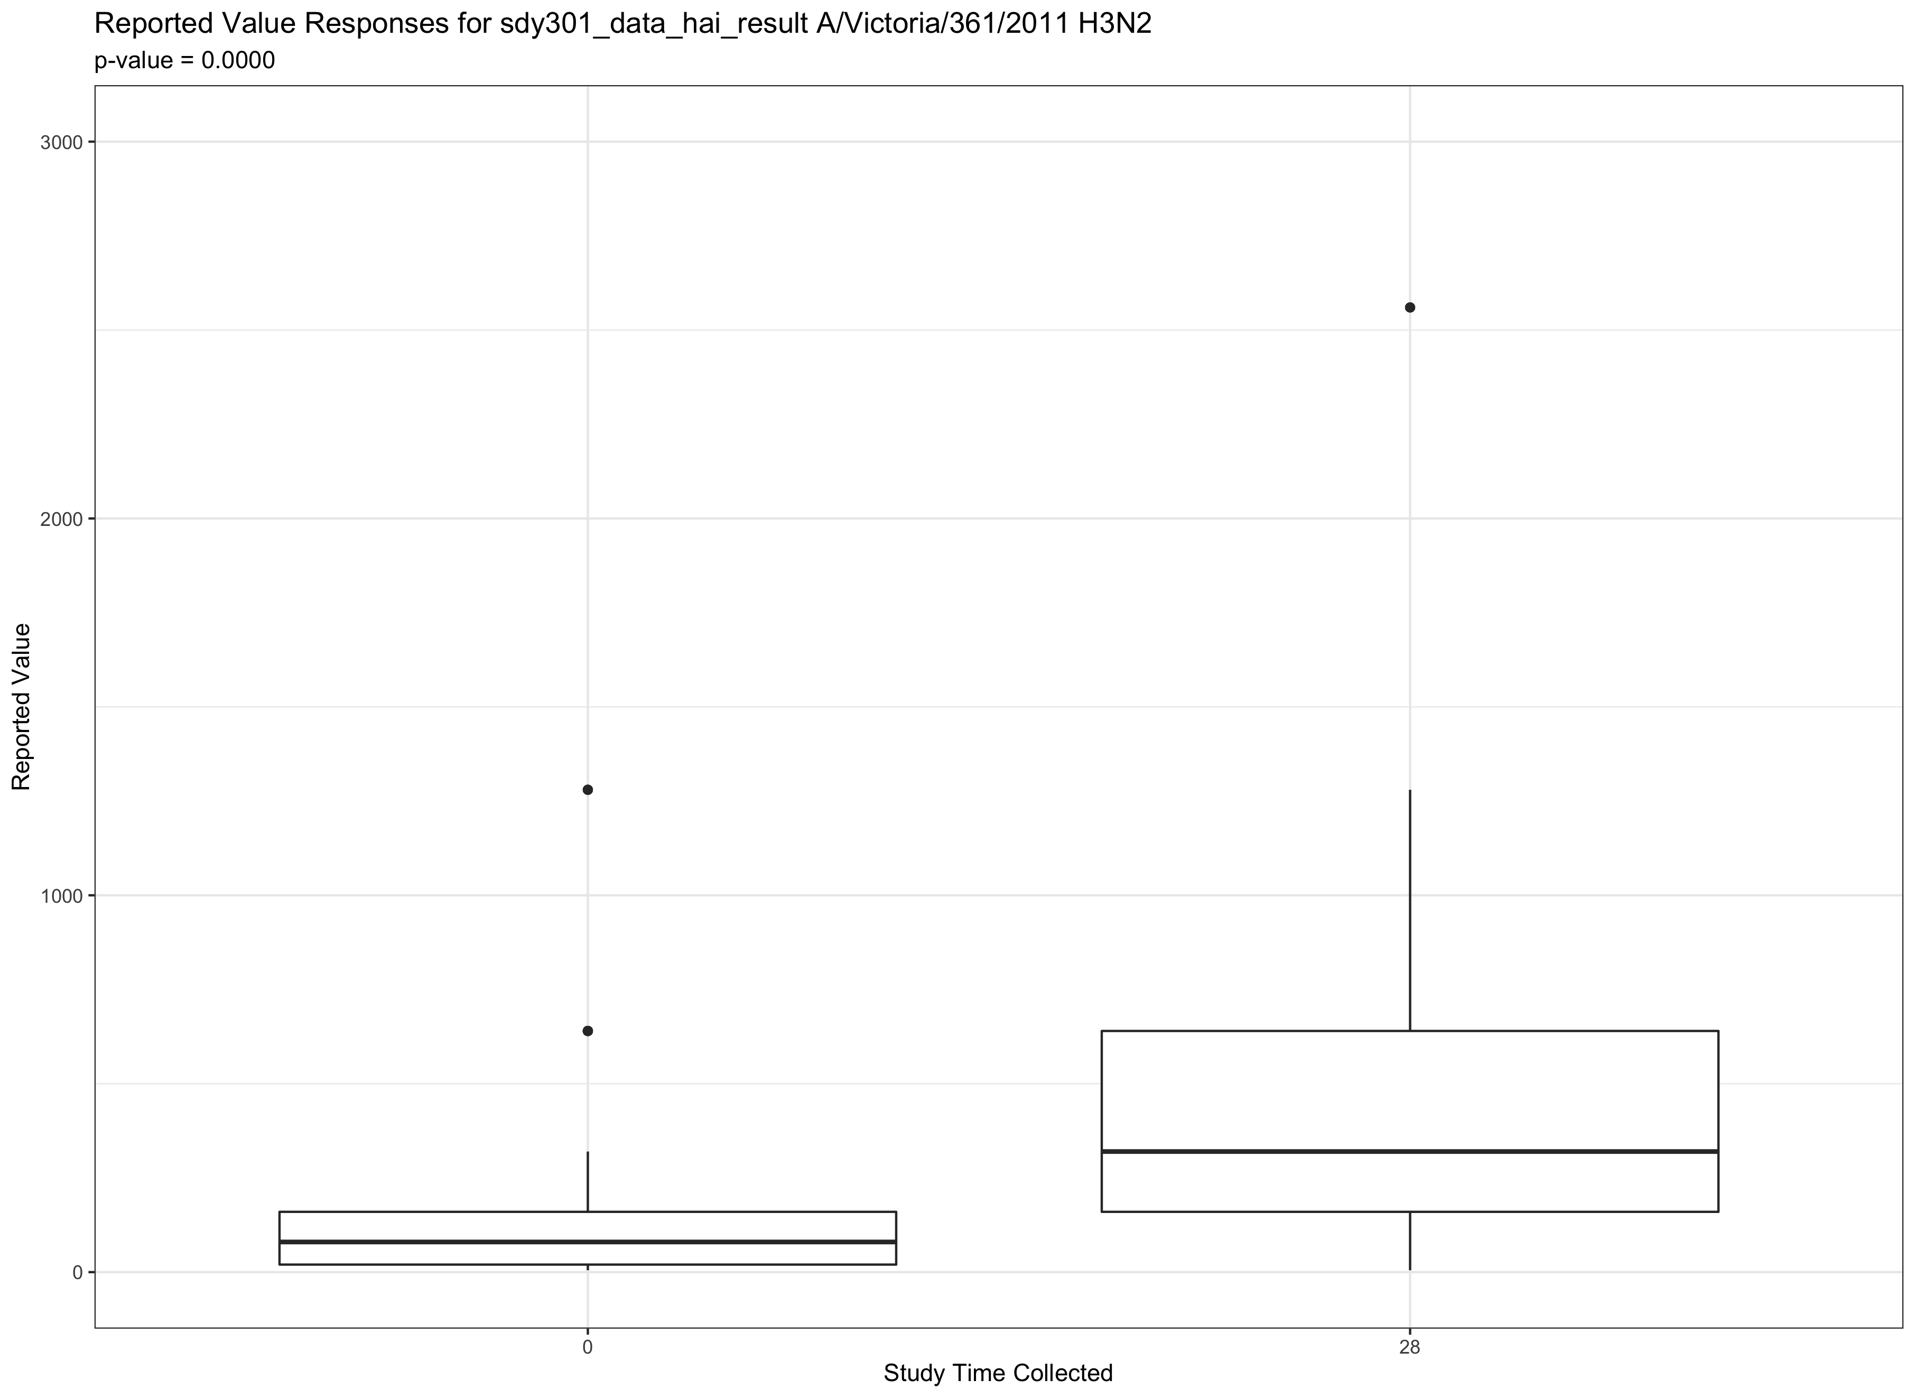
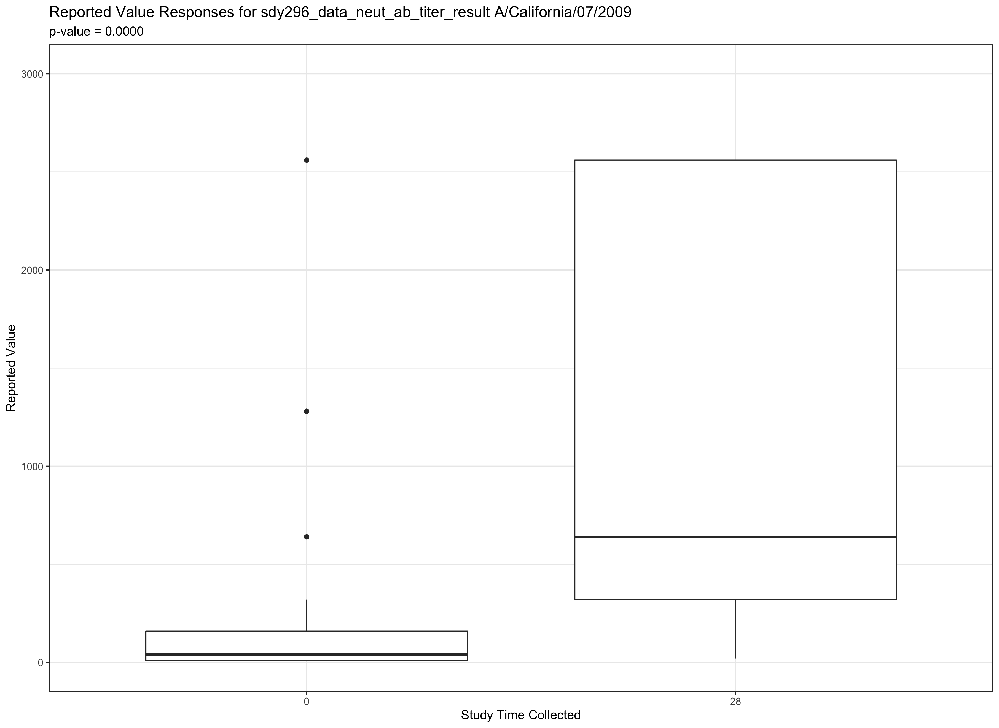
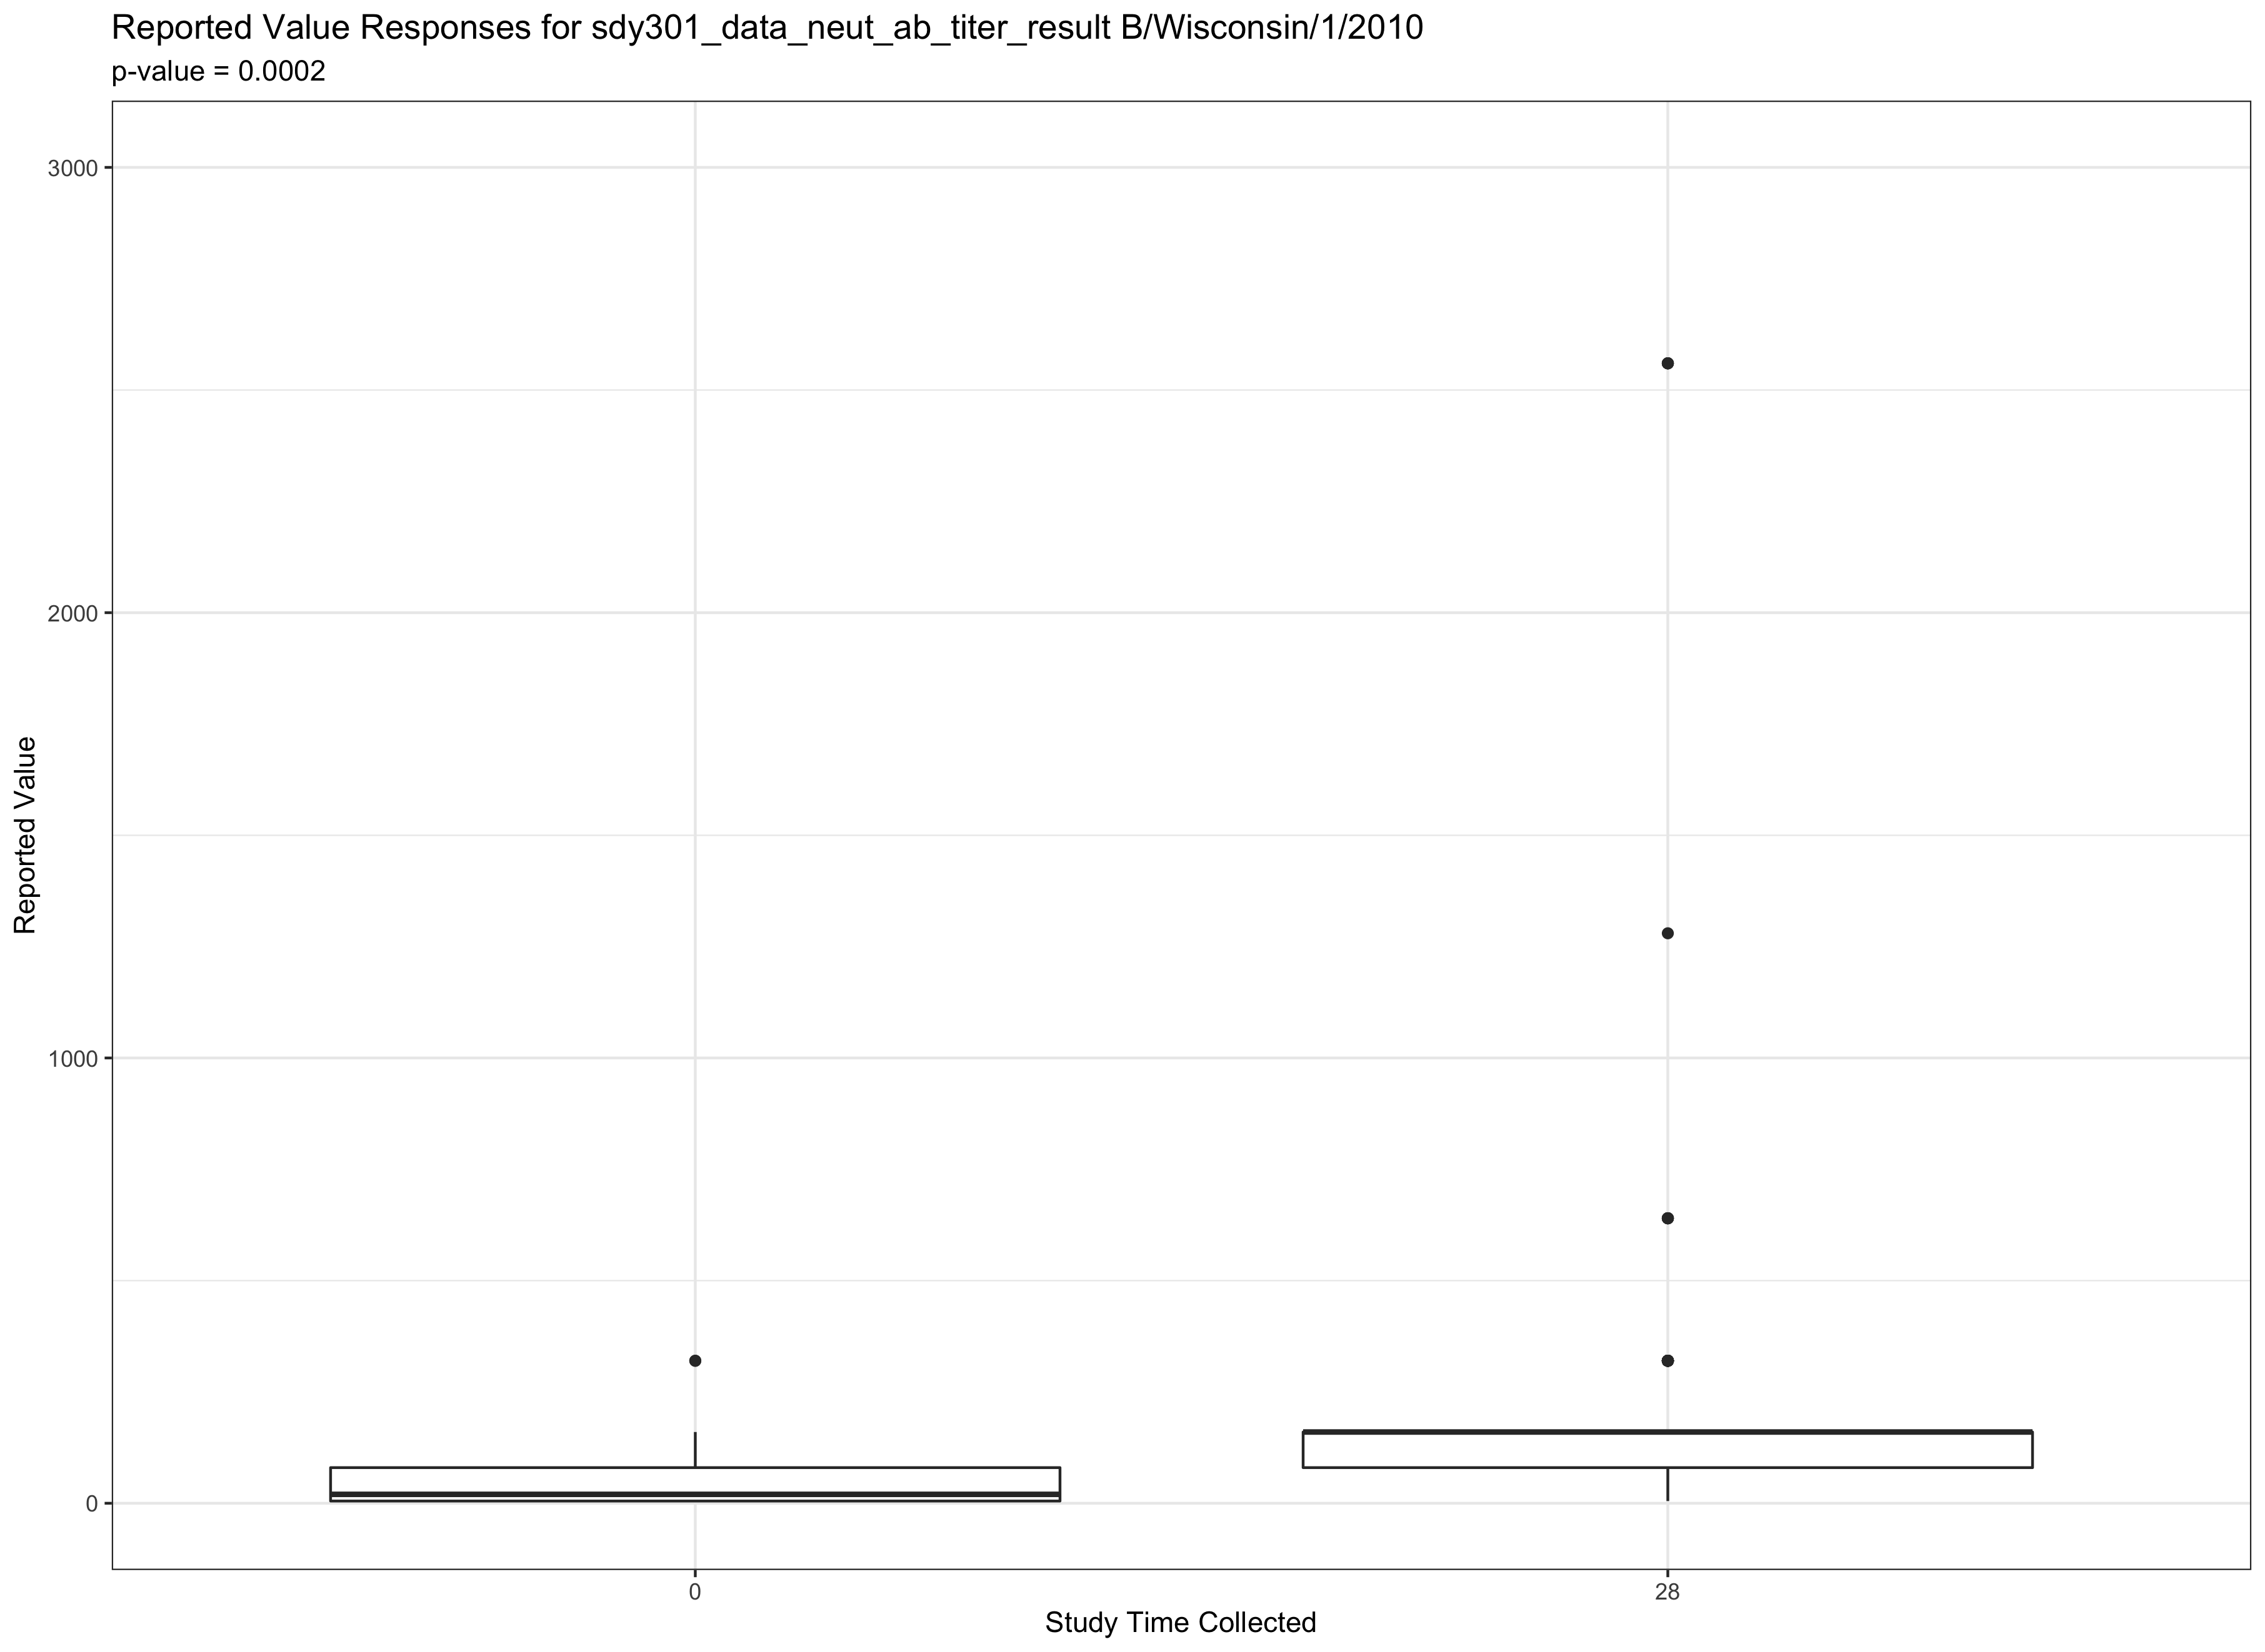
Preliminary data analysis and exploration

Slide 6
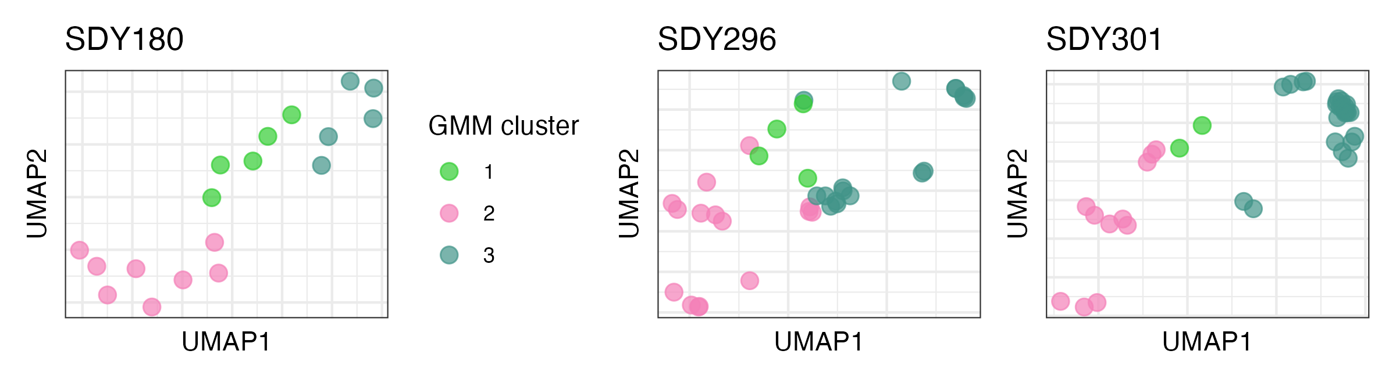

Slide 7
UI Demo and prediction

Slide 8
How we will work with biostatisticians (those who advise regulatory authorities) in the long-term so our platform can help to formalize the discovered markers
Highly collaborative process – crucial to ensure robustness and regulatory compliance of any discovered markers
Engage biostatisticians early in tool development
Regular biostatistician consultations?
Collaborative approach
Familiarize with regulatory guidelines
Guidance on selecting appropriate statistical methods
Validate on independent datasets
Open and transparent communication

Slide 9
How we will ensure our modelling pipelines generalize to new diseases/vaccines
Relies on diverse data collection covering broad range of diseases and vaccines
Incorporate domain expertise – collaborate with experts in the field (epidemiologists/clinicians/immunologists)
Feature selection – use features that are relevant and capture generalizable characteristics
Evaluate the models regularly and cross validation on unseen data
Sensitivity analysis to assess robustness
Model refinement

Slide 10
How we will work with government stakeholders (policymakers and regulators) to ensure that ML methods are embraced and findings trusted. How we would balance this against community needs (e.g. public hesitant about steps being skipped in accelerated vaccine pipeline)
Engage regulatory authorities early and collaborate throughout
Transparent conversation with government stakeholders and community
Acknowledge and address public concerns
Provide clear and accessible information about the scientific basis for the accelerated process
Involce community representatives
Safety monitoring and reporting
Monitor and address misinformation

Slide 11
POST IDEATHON PLATFORM DEVELOPMENT
Ideas for additional analysis
User friendly (no code plug and play)

